Slide 1
Ford and Carter

Slide 2
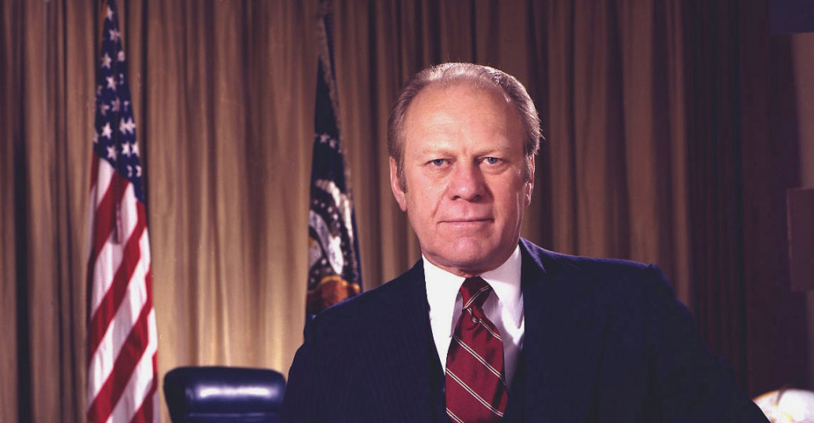
President Ford
Never elected to executive branch
Pardoned Nixon
Good or bad move?
Bad Economy
Goober
https://www.youtube.com/watch?v=8Jsu_qgVuhg

Slide 3
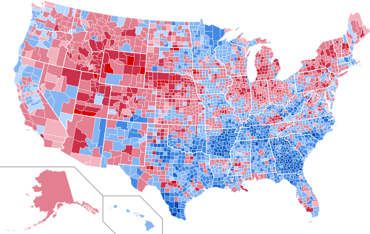
1976

Slide 4
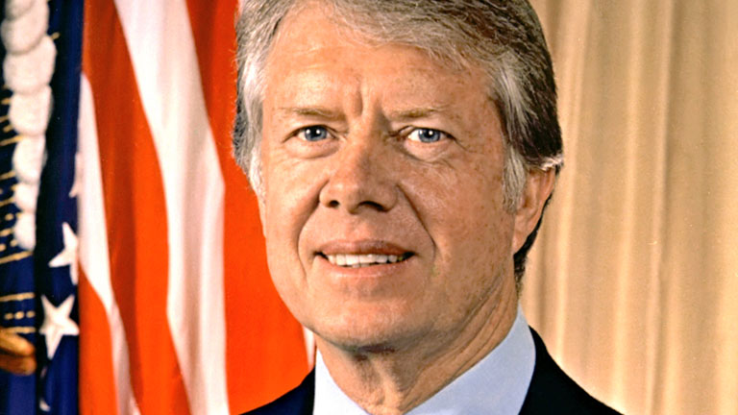
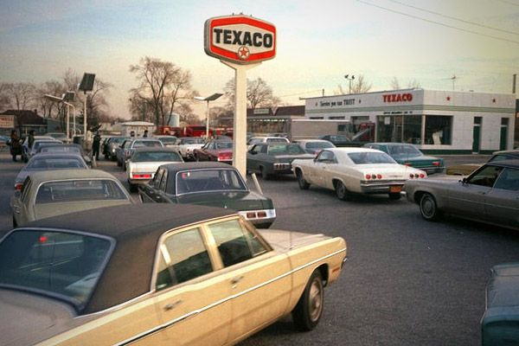
President Carter
Peanut farming Governor of Georgia
OPEC stops selling to US over Israel support
Gas prices skyrocket
https://www.youtube.com/watch?v=MmlcLNA8Zhc
Still large stagflation
Foreign competition and automation

Slide 5
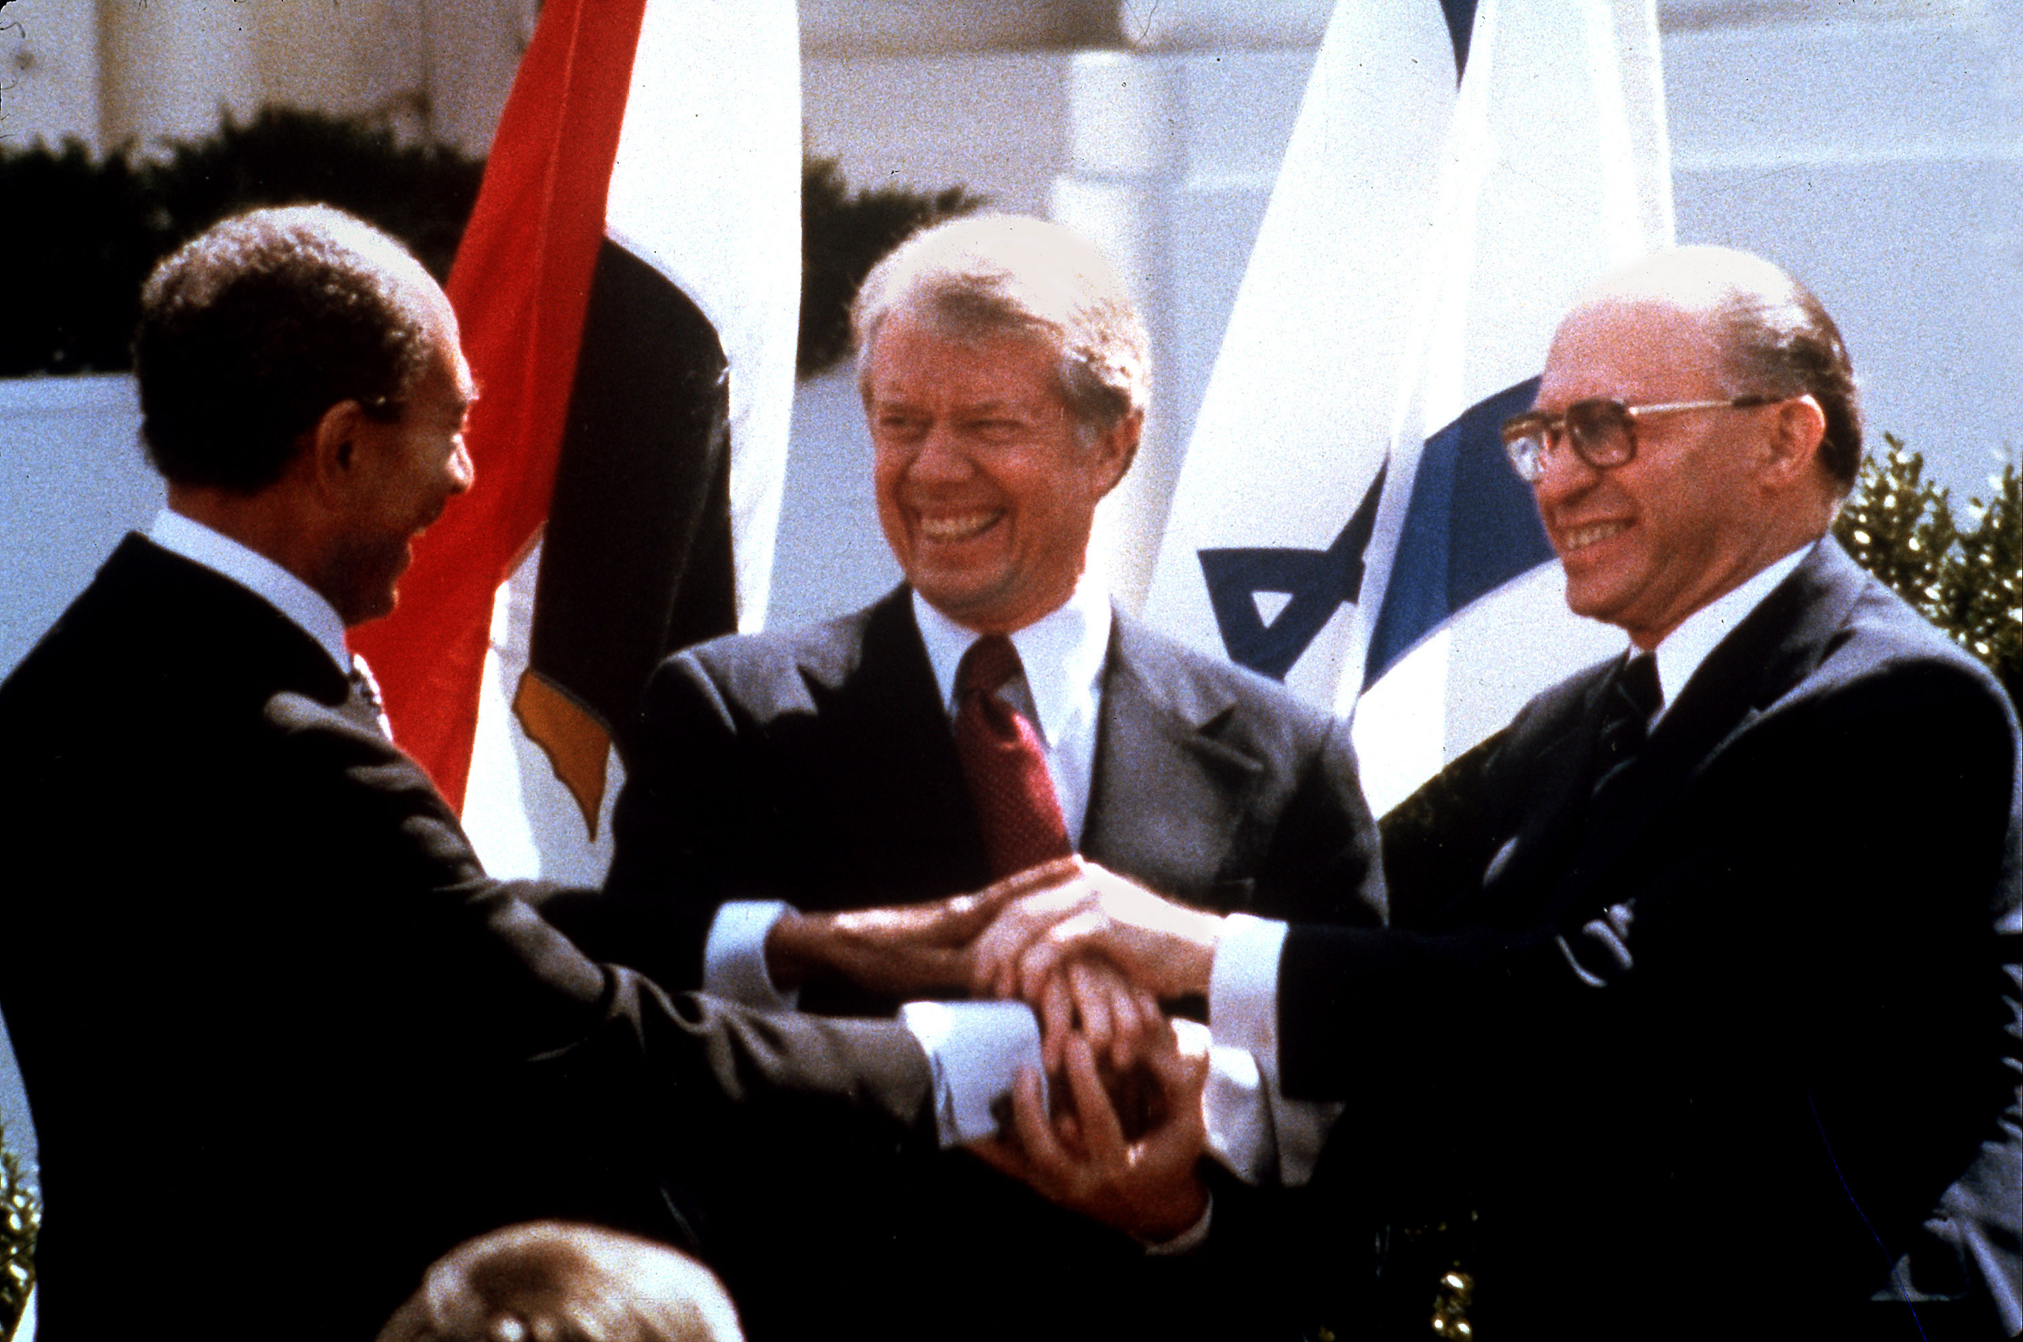
Foreign Policy
Camp David Accords
Agreement between Egypt and Israel
Iran Hostage Crisis
Iran Revolution ousts U.S. backed shah
Seize U.S. embassy and 52 hostages
https://www.youtube.com/watch?v=-6Rt1a1xII8

Slide 6
1980 Election
https://www.youtube.com/watch?v=_VXXwyl5G0A (Reagan Ad)
https://www.youtube.com/watch?v=qN7gDRjTNf4 (Debate)
https://www.youtube.com/watch?v=EU-IBF8nwSY (Morning in America)
Reagan is known as the Great Communicator
Former actor
Knew how to appeal to people’s hearts
Stark contrast with Carter

Slide 7
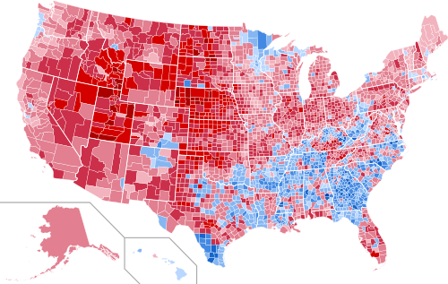
1980

