Slide 1
Wartime America

Slide 2
Drafted For Service
Selective Training and Service Act
Army expands to 8 million by wars end
https://www.youtube.com/watch?v=aDDvpTMABOQ&t=446s
Bases in Florida
Jacksonville
Eglin

Slide 3
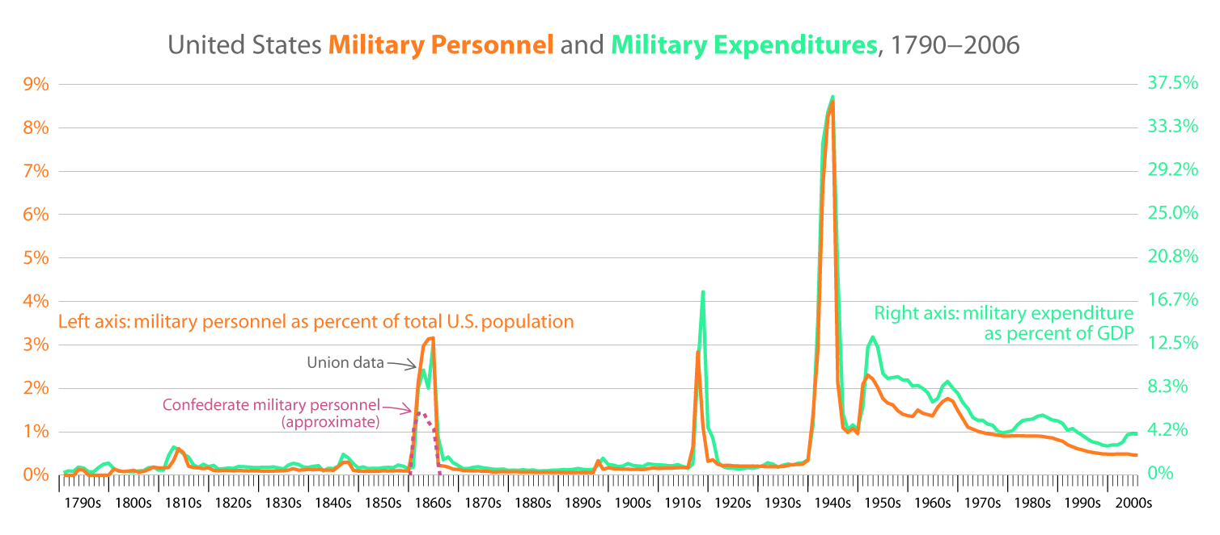

Slide 4
Assignment
On a sheet of paper draw the following graph. Use your textbook to fill it out.
Group | Role in military | Role in economy
African Americans
Mexicans
Native Americans
Women

Slide 5
Group | Role in military | Role in economy
African Americans | Segregated units; Tuskegee Airmen | Executive order 8802 banning discrimination in defense or gov.
Mexicans | Allowed to serve fully | Bracero Program
Native Americans | Code Talkers
Women | Barred from combat; administrative and clerical | Factories and gov., # employed jumps from 13 to 19 million (doesn’t last long) Effects of this?

Slide 6
Injustice
Fighting the Nazis abroad but what at home?
Double V Campaign
African Americans had their own units
Tuskegee Airmen
Executive Order 8802 integrates government offices
Native American code talkers
Relayed critical info. In own language
Bracero Program
Mexicans harvesting crops in the Southwest
Sunbelt
Women barred from combat; served in other capacities

Slide 7
Violence
Wartime creates millions of new jobs
Many move to the Sunbelt
Southern California and Deep South
Knowing makes it harder to hate
As AA and Mexicans move North and West they faced racism and intolerance
Zoot suit riots in LA
https://www.youtube.com/watch?v=8LqNMA3Vpdo

Slide 8
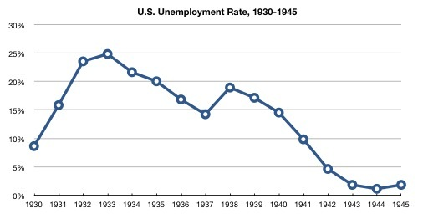
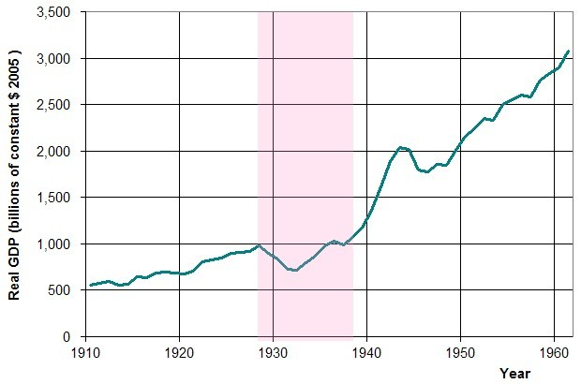
Economy
“The great arsenal of democracy”
https://www.youtube.com/watch?v=00bO_bvfLqM
Cost-plus contracts
Cost to make a product and % of profit
Many factories begin making war supplies
Tanks made in car factories
https://www.youtube.com/watch?v=e8JM0ohyJuo

