Slide 1
Vietnam War Timeline

Slide 2
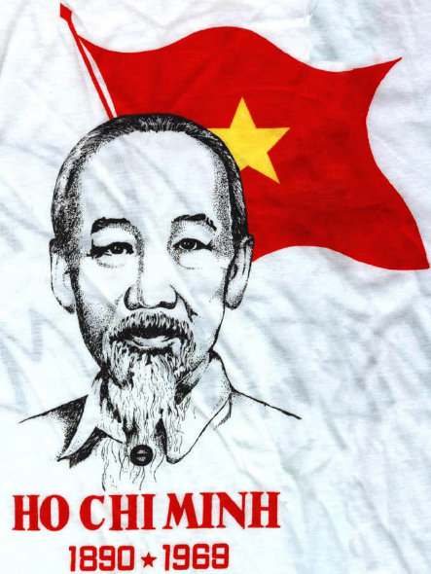
1941(Vietminh)
What: Vietnamese nationalist group founded to expel the Japanese; funded by United States
Why: Would become the group to try and spread Communism throughout Vietnam

Slide 3
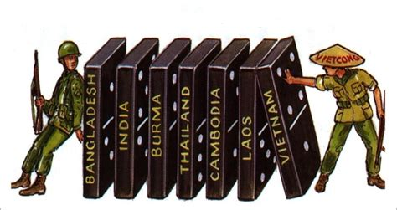
1946 (U.S. Aid)
What: United States sends aid to France to fight Vietminh; Vietnam was a French colony now pushing for independence
Why: U.S. now not supportive of Vietminh to prevent the expansion of communism (domino theory)

Slide 4
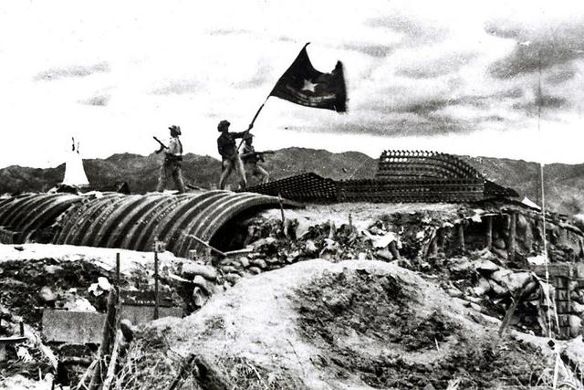
May 7, 1954
What: French forces lose to the Vietminh at Dien Bien Phu
Why: Leads to peace accords and a French withdraw

Slide 5
Key Question #1
Why did Truman and Eisenhower support the French against the Vietminh?
They feared that if Vietnam became communist other countries in Southeast Asia would soon follow (domino theory); China and Korea as examples

Slide 6
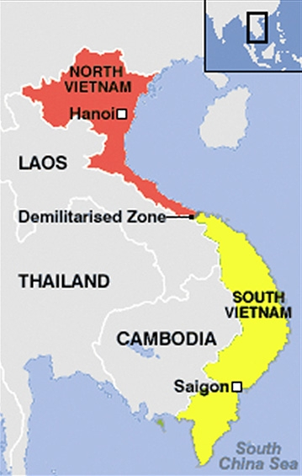
1954-1955 (Geneva Accords)
What: France and Vietminh agree to divide Vietnam at the 17th parallel; Ho Chi Minh in North and Diem in South (Communism vs. pro-Western)
Why: End of conflict and French withdraw leaving the United States to protect pro-Western South Vietnam and Diem (very unpopular)

Slide 7
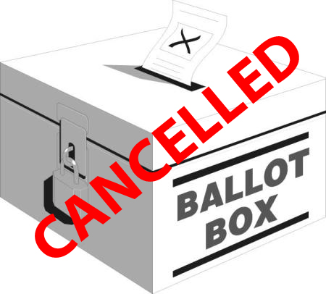
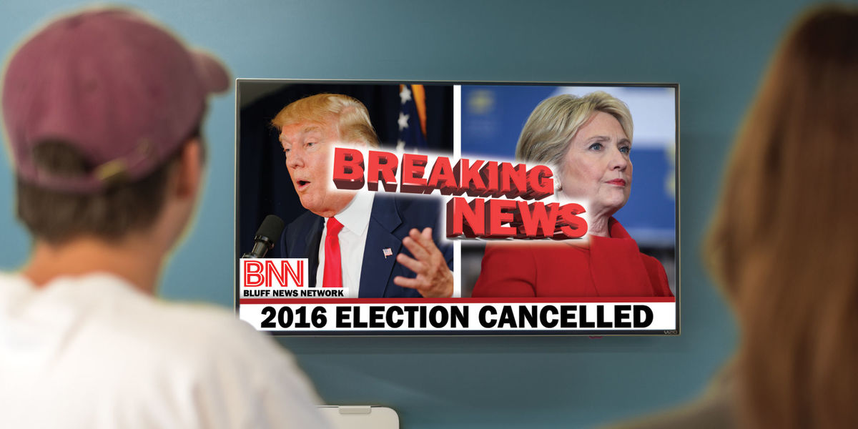
1956 (Elections)
What: Diem cancels elections in anticipation of losing; Eisenhower supports this
Why: Angers the people and demonstrates U.S. hypocrisy (loving free and fair elections until they don’t go our way); Eisenhower sends military advisers to protect from Vietcong

Slide 8
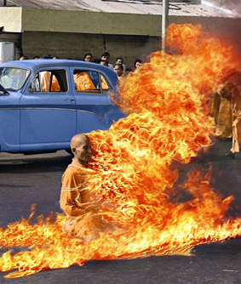
Spring 1963
What: Diem bans Buddhist religious flags as an act of further discriminating against Buddhists; monk lights himself on fire
Why: Seen around the world and leads many to question the motives of the U.S. and Diem

Slide 9
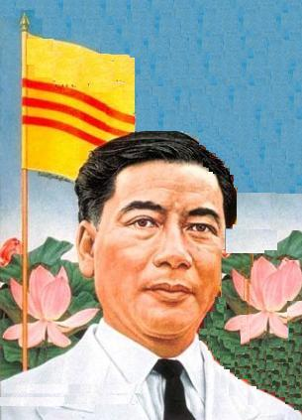
November 1, 1963
What: Military coup ousts Diem from power
Why: The already precarious and unpopular South Vietnamese government weakens

Slide 10
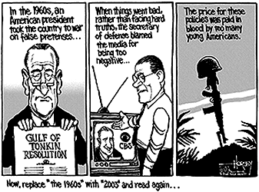
August 2nd, 7th 1964
What: North Vietnamese ships destroyed two U.S. ships in the Gulf of Tonkin unprovoked (proven to be false); Congress passes Gulf of Tonkin Resolution
Why: President given broad war powers traditionally reserved for Congress

Slide 11
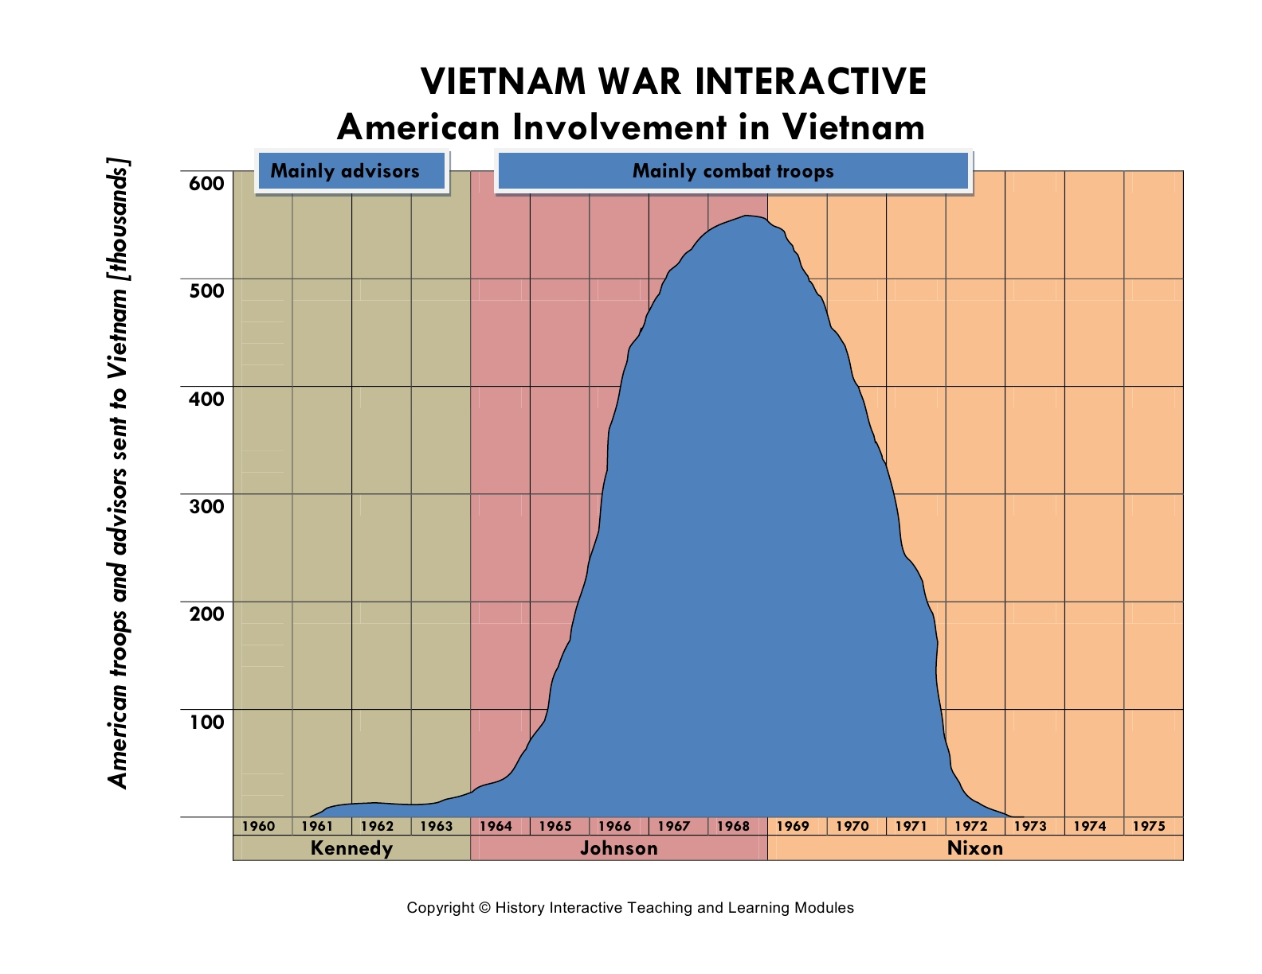
March 1965-end of 1966 (Troop Surge)
What: Close to 400,000 troops sent to Vietnam
Why: Demonstrated American determination and commitment to win the war

Slide 12
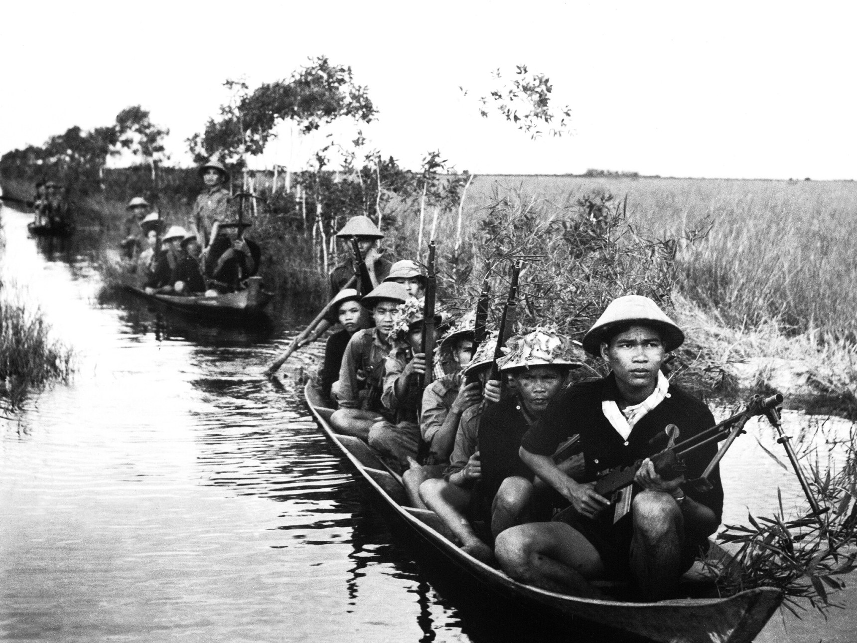
Key Question 2
Why was it so difficult to fight the Vietcong?
Used guerilla warfare and blended in with citizens

Slide 13
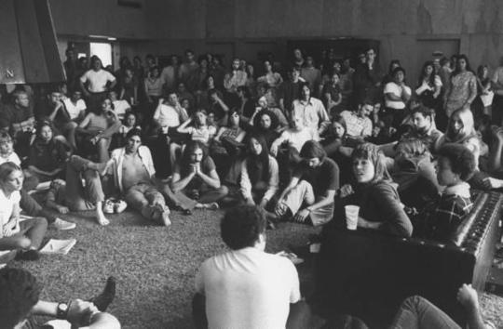
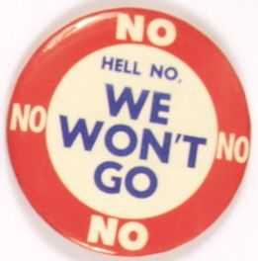
Key Question 3
Who were the doves and who were the hawks?
People who wanted the U.S. to leave Vietnam (students, professors) and those who wanted to stay and fight the war. Counter-culture develops.

Slide 14
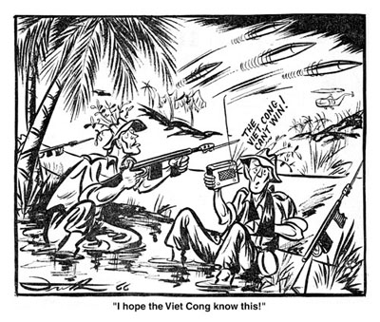
January 30, 1968
What: Massive attack launched on Vietnamese New Year by the North on the South
Why: Hurt American morale; media begins to turn against the war and question if it could be won
Cronkite Vietnam

Slide 15
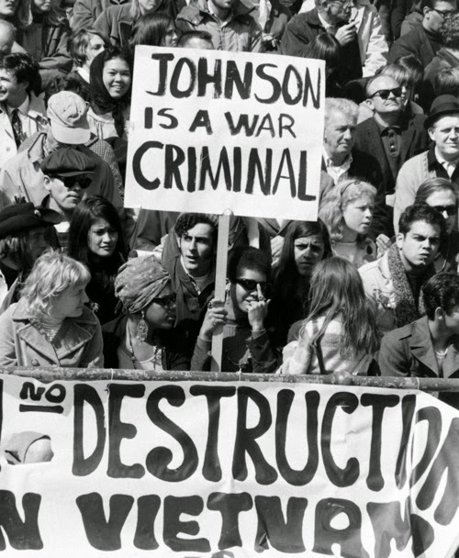
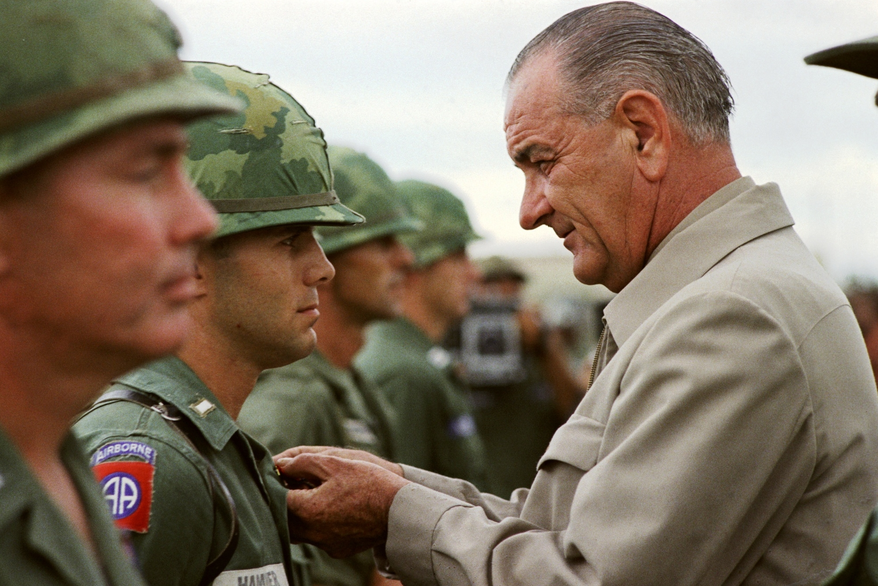
March 31, 1968
What: Lyndon Johnson, unpopular and facing a primary challenge, decides not to run for re-election as President
Why: Demonstrates the political impact of the Vietnam War and its growing unpopularity
Johnson Re-election Speech

Slide 16
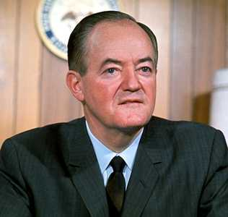
1968 Democratic Convention
What: RFK had been front-runner before assassination; VP Hubert Humphrey selected as nominee amid protests happening outside in the streets of Chicago
Why: Televised and showed how unpopular the current government was and the tangible anger of the American people
1968 Democratic Convention

Slide 17
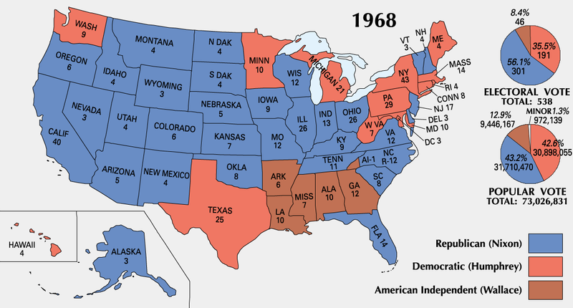

Slide 18
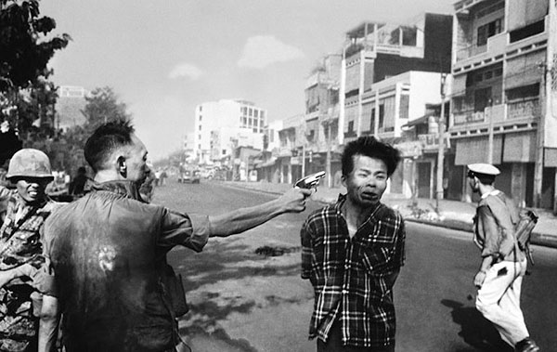
June 8, 1969
What: Nixon withdraws 25,000 soldiers and emphasizes that South Vietnam should assume more of the fighting (Vietnamization), but increased airstrikes in Cambodia
Why: Showed the U.S. government’s dishonesty as well as inability to surrender/concede defeat; leads to repeal of Gulf of Tonkin Resolution

Slide 19
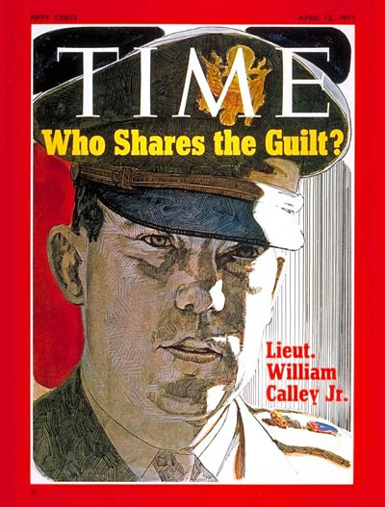
Late 1969/Spring 1968 (My Lai)
What: Americans found out about the actions of Lieutenant William Calley in 1968 when he massacred a village in the hamlet of My Lai; later sent to jail
Why: Further eroded support of the war effort

Slide 20
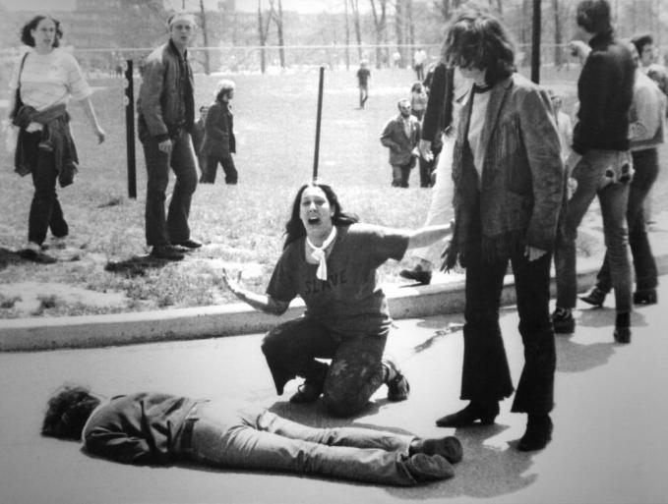
May 4, 1970
What: Students at Kent State protesting the expanded war into Cambodia were shot by Ohio National Guard, killing four.
Why: Demonstrates emerging conflict between citizens and the government

Slide 21
Key Question 4
Why were the Pentagon Papers significant?
Explained details about the decision to expand the war, demonstrating that the government had been dishonest.

Slide 22
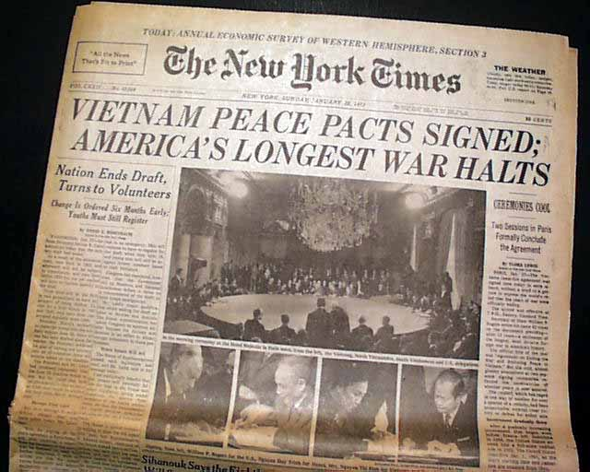
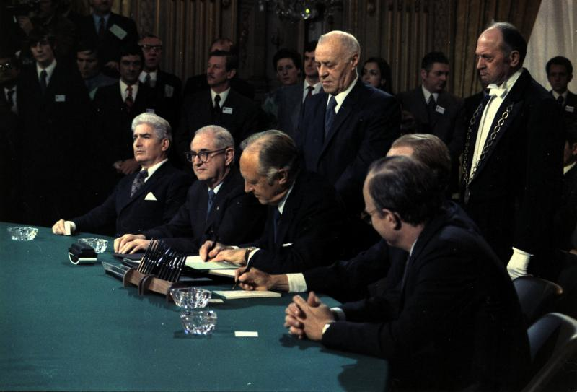
January 27, 1973
What: After intense, destructive air raids a peace agreement is signed
Why: The U.S. ending it’s direct involvement in Vietnam

Slide 23
Key Question 5
How did the “Domino Effect” play out?
Cambodia falls to Khmer Rouge, South Vietnam falls to North Vietnam (Saigon), Laos falls to Communism

Slide 24
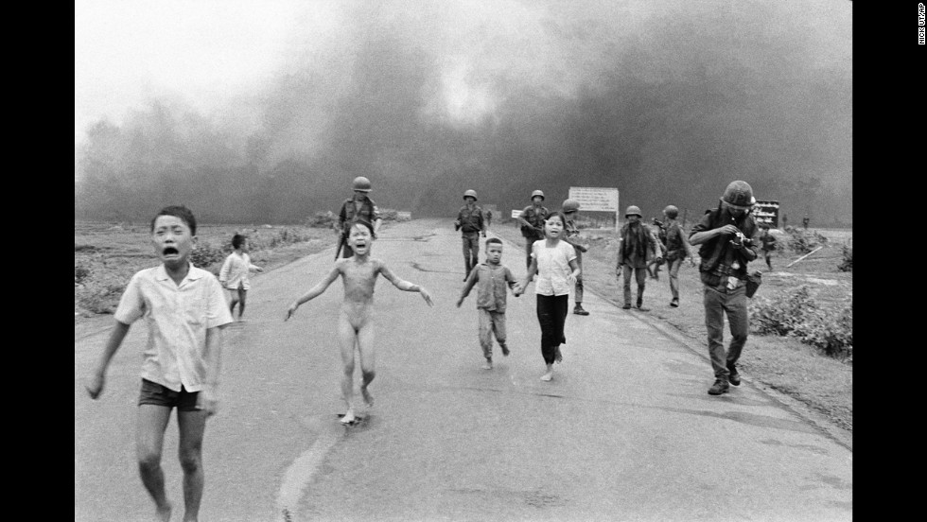
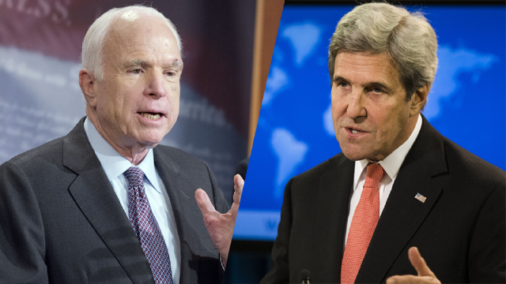
Key Question 6
What was the human toll of the war?
58,000 dead; 300,000 injured; millions of Vietnamese soldiers and citizens dead; PTSD; unexploded land mines

Slide 25
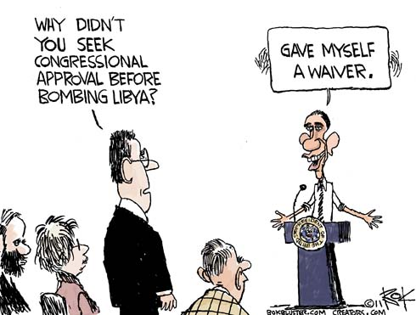
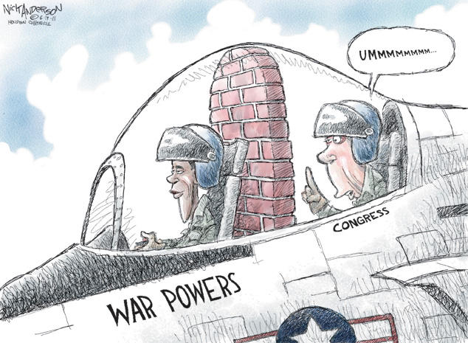
1973 (War Powers Act)
What: Requires President to inform Congress within 48 hours of a troop commitment and withdraw between 60 and 90 days unless approval by Congress has been given
Why: Attempt to reign in unchecked presidential power; largely ignored

Slide 26
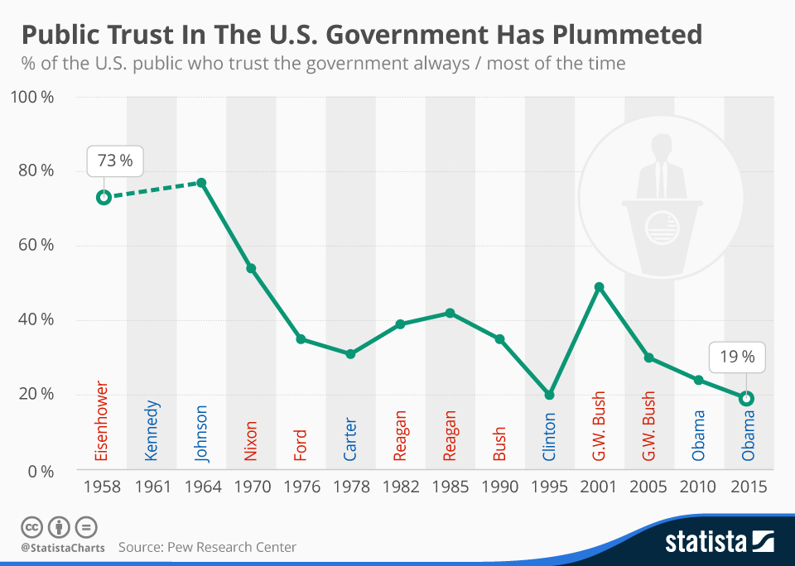
Key Question 7
How did the Vietnam War changed the public perception of both the military and the government?
Veterans went unrecognized; public esteem of military plummets; public trust in government begins a steep downward trend that still holds today (VERY important for political issues today); shakes U.S. confidence

Slide 27
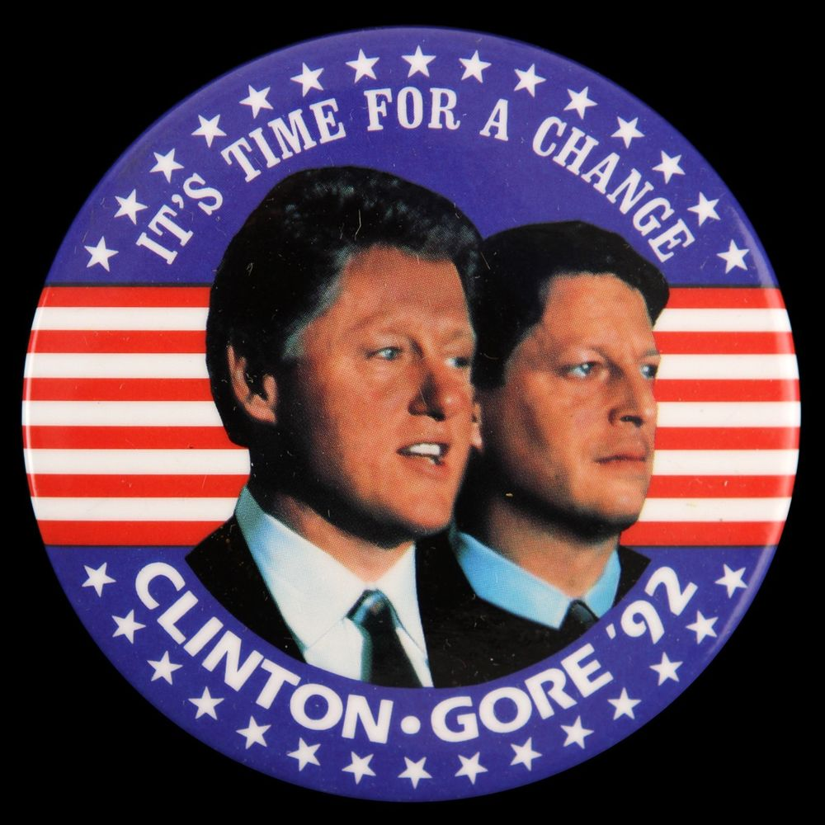
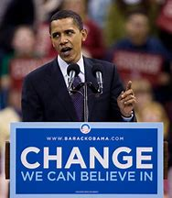
Connections To Today
Candidates run and win on a suspicion of government, promises to change things
2016 exit poll data
38% said #1 thing they were looking for in a candidate was change
Obama-Trump voters
61% say the country is headed down the wrong track
80% say angry or frustrated about the way the federal government works

Slide 28
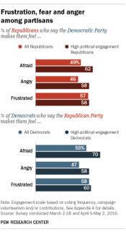
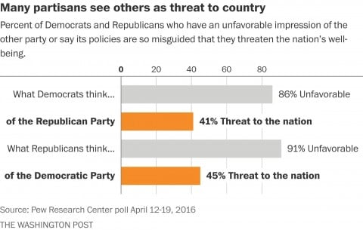

Slide 29
