Slide 1
The Gilded Age
Riches and Rags

Slide 2
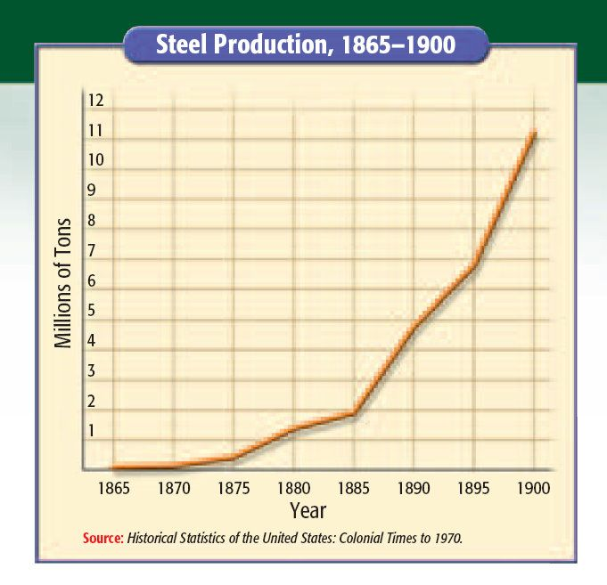

Slide 5
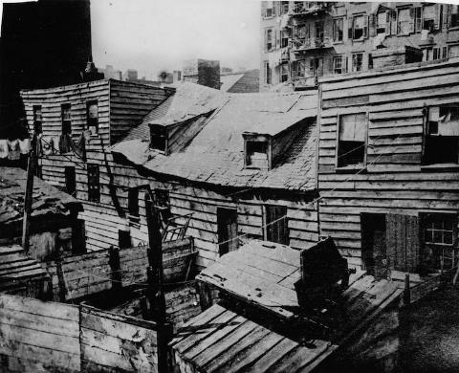
Cities
Rapidly growing due to immigrants, industry
What problems may arise with rapid growth?
Sanitation, health, safety, crowded, transportation, water, crime, fire, etc.

Slide 6
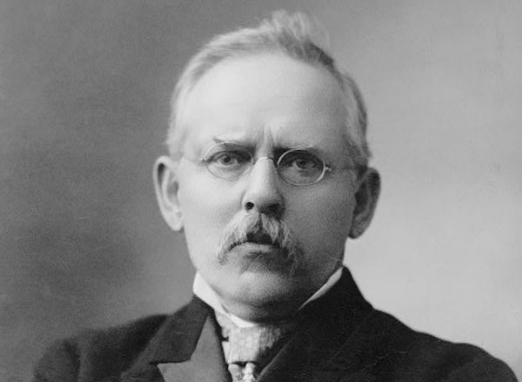
Jacob Riis
“How The Other Half Lives”
Photographs exposing life in the slums

Slide 7
Political Machines
Controlled political party activities
Offered services to voters and businesses for votes
Many immigrants involved
City bosses and their subordinates helped elect friendly politicians
Controlled access to jobs
Control of government and money ensured voter loyalty

Slide 8
Political Machines
Political Machines
Rapid growth
Inefficient government
Social Darwinism

Slide 9
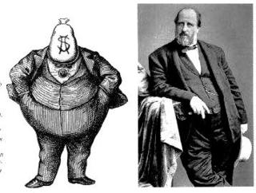
Fraud and Graft
Fake names, voter fraud
Illegal use of office for personal gain
Boss Tweed
Tammany Hall (Dem)
Extravagant graft
Thomas Nast

Slide 10
Gangs of New York
https://www.youtube.com/watch?v=W5DwnNPHVAU

Slide 11
Social Darwinism
Stresses individualism
You are where you’re at because of you
Ignores context/other factors
Social Gospel Movement
Jane Addams Hull House
Seeks to aid the poor; salvation through service

Slide 12
Patronage vs. Civil Service
Giving gov. jobs to supporters vs. to most qualified candidate
Hayes (Comp. 1877) doesn’t seek re-election and Republicans divided
Stalwarts-patronage
Reformers (Half Breeds)-civil service
James Garfield nominated (Half Breed)
Chester Arthur VP (Stalwart)

Slide 13
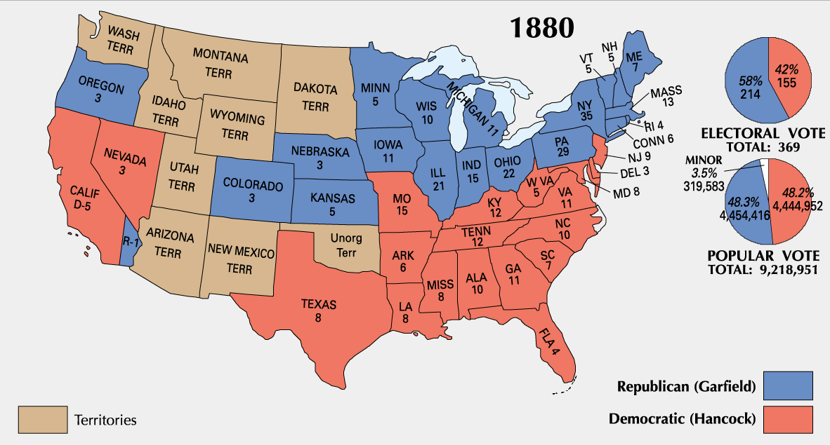
Election of 1880

Slide 14
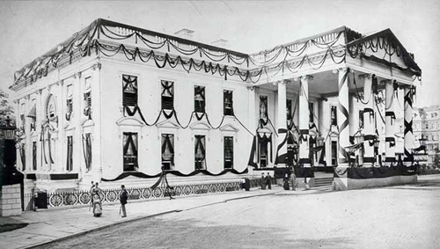
Assassination
President Garfield shot by Charles Guiteau
Disgruntled government worker
“I did it and I will go to jail for it. I am a Stalwart and Arthur is now president.”

Slide 15
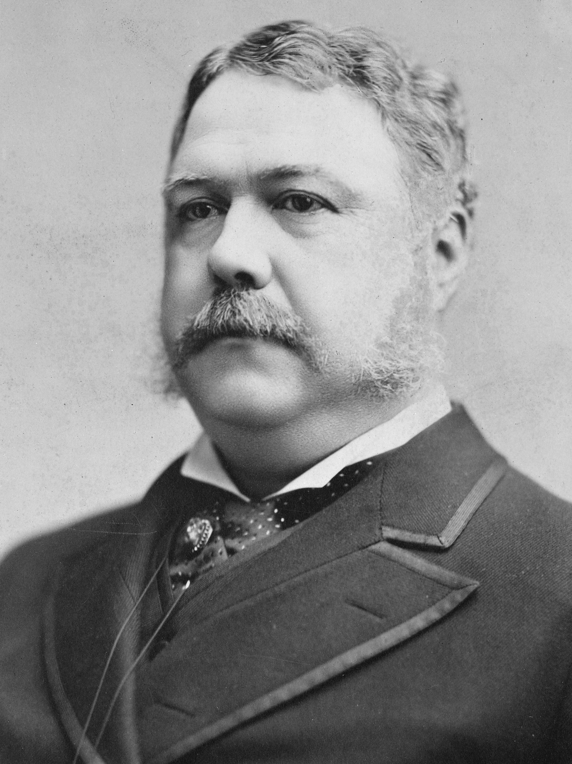
Pendleton Civil Service Act
Despite being a Stalwart, President Arthur becomes a reformer
Civil service commission to make appointments to federal jobs by merit
More honest and efficient
Politicians turn to other means for funds
Can no longer offer jobs

Slide 16
Election of 1884

Slide 17
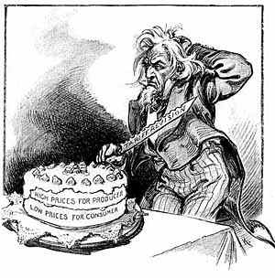
Tariffs
Businesses wanted high tariffs
Tax on imported goods
Helps American business
Democrats low tariffs
Lower prices

Slide 18
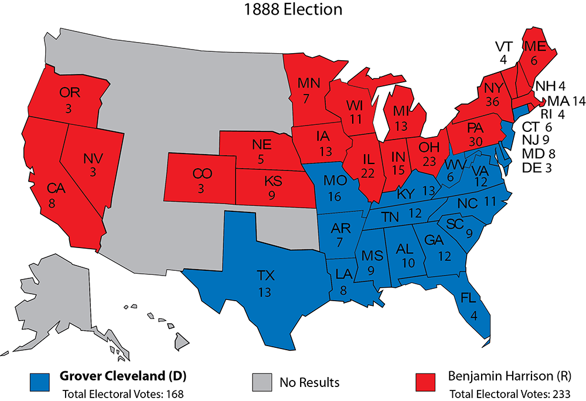
Election of 1888

Slide 19
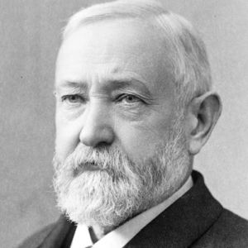
Benjamin Harrison
Wins presidency despite losing popular vote
McKinley Tariff Act raises tariffs to highest rates
Campaign financed by business

Slide 20
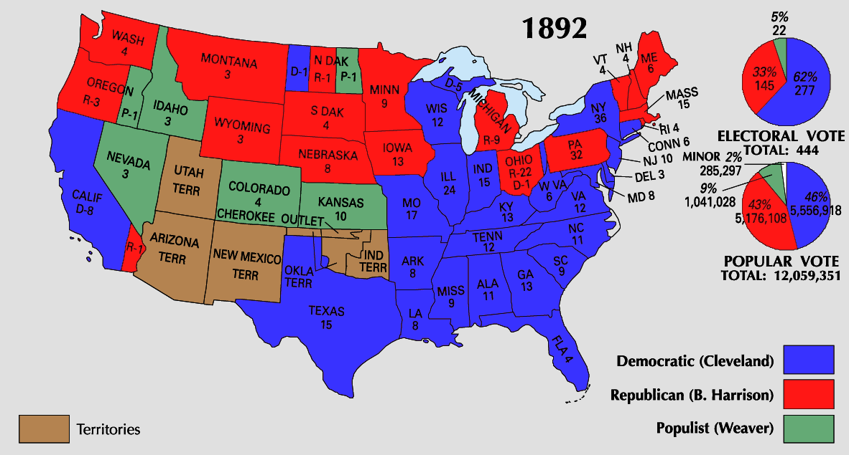
Election of 1892

