Slide 1
Rationing and Sacrifice

Slide 2
Brainstorm
How do individuals contribute to war?

Slide 3
What To Do
Rationing
Only allowed a certain amount of each good
Booklet
Victory Gardens
Paying Taxes
War Bonds (over $150 million)
“All in this together” mindset; everything in service of your country and fellow citizens over yourself
Do we have this mindset today? Why or why not? Are we Americans first?

Slide 4
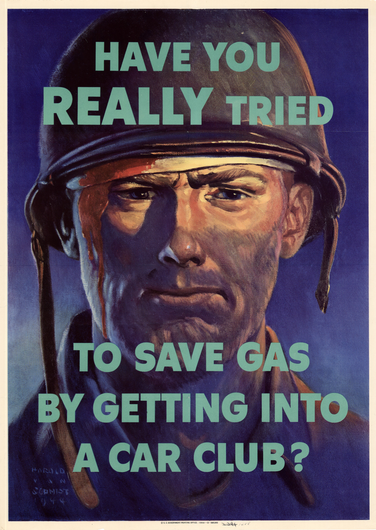

Slide 6
How To Ration?
You and a partner will be given a rationing packet
The first page is directions READ THEM
The second page is a list of foods, # of servings, the price, and ration points.
You and your partner will have to plan a breakfast, lunch, and dinner with $2.00 and 48 ration points
Fill out the chart on the back of the second page as well as the “Summary” and questions on the first page

