Slide 1
Farmer Woes and Populist Dreams
The People’s Movement

Slide 2
As farmers reaped less and less profit despite more and more work, a vocal anger arose
“What you farmers need to do is to raise less corn and more Hell! We want the accursed foreclosure system wiped out…We will stand by our homes and stay by our firesides by forces if necessary, and we will not pay our debts to the loan-shark companies until the Government pays its debts to us.”

Slide 3
Farmers Alliance
Long haul vs. short haul rates
Interstate Commerce Commission helps but largely ineffective (Question 1,2)
Oliver Hudson Kelley starts the Patrons of Husbandry (The Grange)
Social outlet and education to isolated farmers
Farmers’ Alliances
Talked about political issues
Interest rates
Railroads and banks

Slide 4
Larger Economic Issues (Question 3,4)
U.S. issued a lot of paper money during Civil War
Called Greenbacks (not backed by gold or silver; valuable because gov. says it is)
More money printed leads to inflation
More money in circulation means it’s less valuable; prices increase aka need more of it to buy things
U.S. takes some greenbacks out of circulation
Less money in circulation = deflation; value increases
Money worth more so prices drop
You need less of it to buy things because it’s more valuable
Good for consumers; bad for farmers

Slide 5
A Vicious Cycle
Falling crops prices; Wheat goes from $2.00 to .68 cents
Mortgage homes to buy more land for more crops
Farmers can’t pay bills
Banks foreclose on homes

Slide 6
Populism (6)
Movement of the people
First convention in Omaha, Nebraska 1892
Platform:
Increase money supply, income tax, federal loan program, secret ballot, and an 8 hour workday

Slide 8
Panic of 1893
Bankruptcy
People panic, trade in greenbacks for gold
Gov. gold supply is low so can’t fulfill promises
Farmers in debt
Railroads expanding faster than markets
Stocks plunge
No investment, economy plunges

Slide 9
Retraction
Along with stopping printing greenbacks, gov. decided not to make silver into coins
Now even less money=more deflation=worse for farmers

Slide 10
Bimetallism (Question 5)
Bimettalism- use gold and silver for money
More currency available, less valuable dollar
Products at higher prices, more people have money
Democrats, farmers, laborers, populists

Slide 11
Gold Standard
Gold Standard- only use gold for coins
More stable but expensive currency
Money more valuable=lower prices
Republicans, businessman, “Gold Bugs”

Slide 12
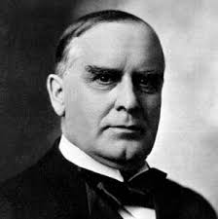
1896 Election (Question 6)
Republicans nominate William McKinley
Democrats nominate William Jennings Bryan
Picks off the Populists as a third party
Some Democrats fear the bimetallism because of increased prices
Good for farmers, not consumers

Slide 14
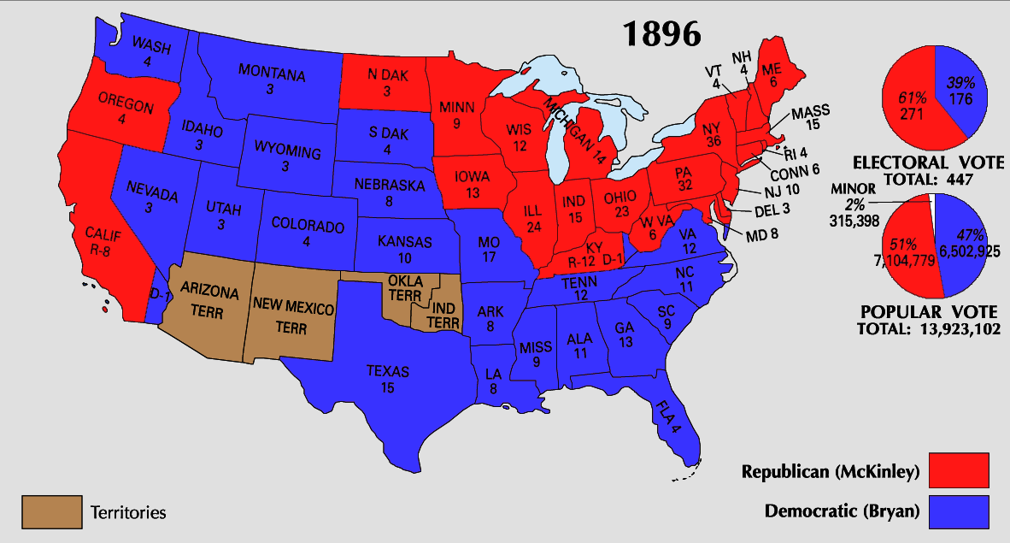
1896 Election
Populists for Bryan; decline after this

Slide 15
Populist Legacy (Question 7)
Couldn’t break through the two-party system
Racism and anti-immigrant stance hurt appeal to laborers, many of whom were minority
Advocated gov. intervention which would become popular soon but not yet
What things did they advocate for that we now have?
8 hour workday, graduated income tax, worker protection, regulation of business

Slide 16
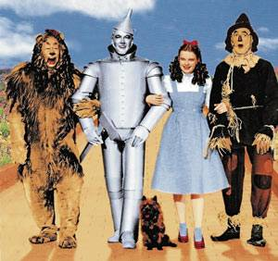
Wizard of Oz and Populism
https://www.youtube.com/watch?v=lg93I5ydyNo

