Slide 1
9 Weeks Grades
Semester Grade = average of 1st and 2nd 9 weeks
Round up “9’s” if no zeros in gradebook

Slide 2
History Fair
One “Rules” packet per group printed by 10/22 (Monday)
You are responsible for adhering to your category rules.
Nhd.org

Slide 3
Sources
Primary vs. Secondary?
5 secondary sources minimum due by 11/2
May have a media center day
Your sources should be varied and must be deeper than (bio.com, history.com, etc.)
Start with these sources for basic knowledge and then go deeper. You will not get credit for basic sources like these.
We will review how to make a bibliography next week

Slide 4
Origins of Progressivism

Slide 5
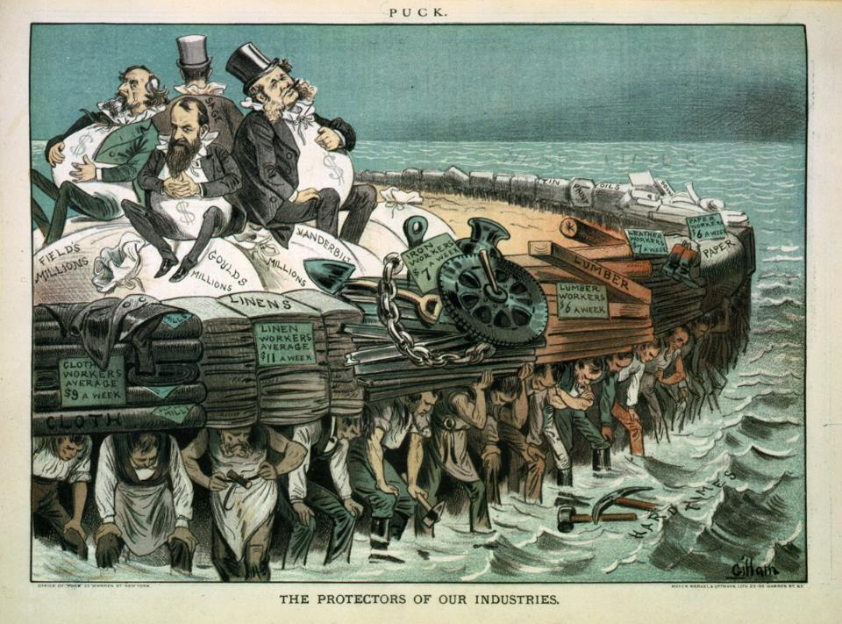

Slide 6
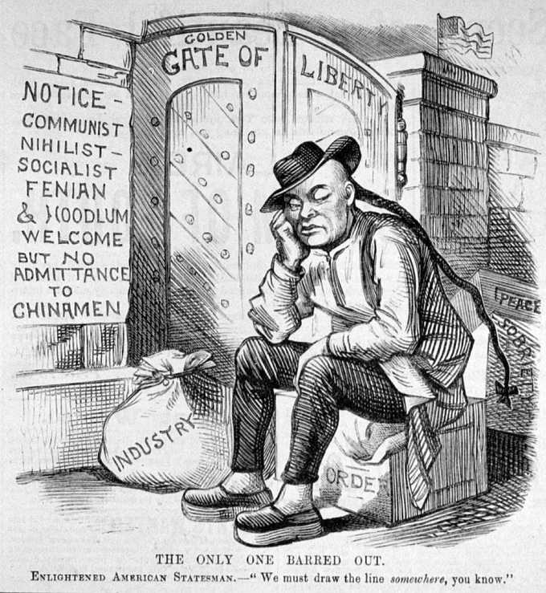

Slide 7
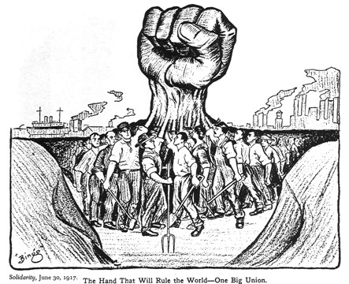

Slide 8
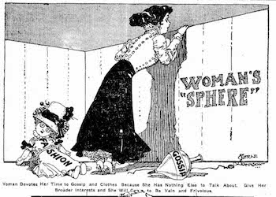

Slide 9
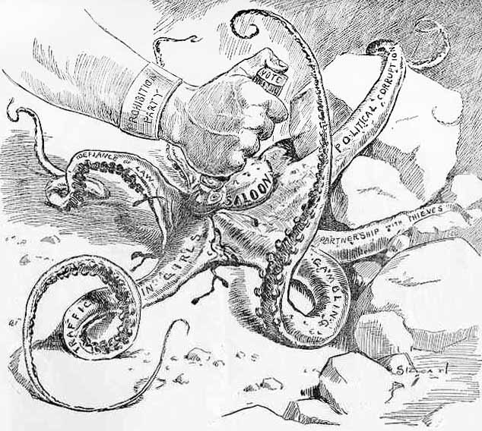

Slide 10
Backlash
US History is full of complementary periods bringing different levels of government involvement and progress etc.
Antebellum/Civil War (1850-1865)
Reconstruction (1865-1876)
Gilded Age (1876-1900)
Progressive Age (1900-1920)
WW1 (1913-1920)
Isolationism/Nationalism/Laissez Faire (Roaring 20’s)
Great Depression/WW2/Liberal Expanded Gov. (1932-1968)
Conservative Revolution (1968-2008)
Liberal World Order (2008-2016)
Nationalism/Isolationism (2016-?)

Slide 11
Time Periods
Progressivism is a reaction to the Gilded Age
Massive inequalities, worker safety, health of community, lack of opportunity, no “fair playing field” for the people

Slide 12
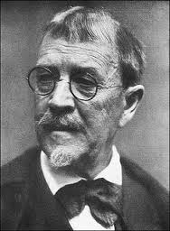
Exposed
Journalists and writers expose unsafe conditions and inequalities in life
Muckrakers
Leads to belief that government needs to play a larger role
Progressivism is generally thought to have four main goals

Slide 13
Promoting Social Welfare
Soften harsh conditions
Social Gospel and settlement house
YMCA
Child labor, working conditions etc.

Slide 14
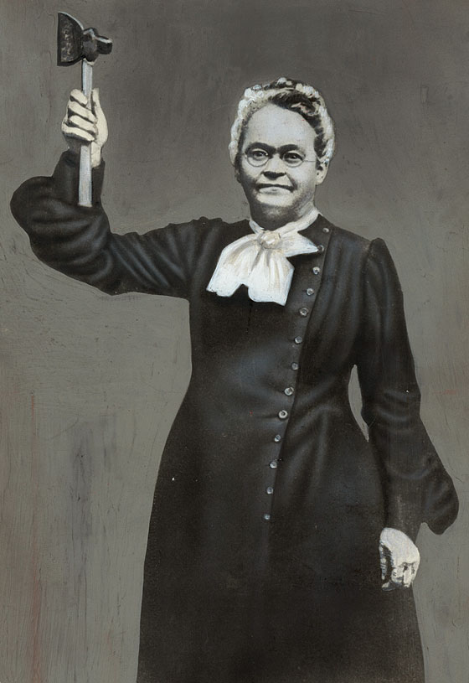
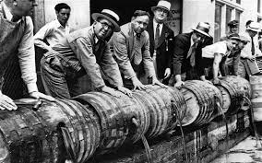
Promoting Moral Improvement
Morality, not the workplace, improved lives

Slide 15
Crating Economic Reform
Panic of 1893 leads many to question pure capitalism
Laissez Faire
Uneven balance between business and people
Favorable legislation for business
“Playing with loaded dice”
Square Deal

Slide 16
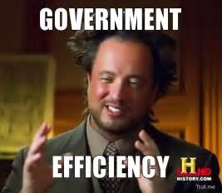
Fostering Efficiency
Using scientific principles to make the workplace and government more efficient
Studies in how fast tasks could be performed and the right conditions to improve labor
Reform government by rooting out corruption

Slide 17
Muckrakers
Individually, you will read your assigned primary source and fill out the document analysis sheet
Find your group (1-5)
Compare what you wrote on the document analysis sheet
Fill out one row of boxes on the graphic organizer
Then, on the large sheet of paper write:
The author and name of the work
The problem they are describing
Solutions
Main idea
Hang up around room. Go and fill in your graphic organizer.

