Slide 1
QOTD 4/13
“By 1968, you can’t say [things like that], that hurts you, back-fires. So you say stuff like forced busing, states rights, and all that stuff and you’re getting so abstract. Now you’re talking about cutting taxes. We want to cut this is much more abstract than even the busing thing.”

Slide 2
Nixon

Slide 3
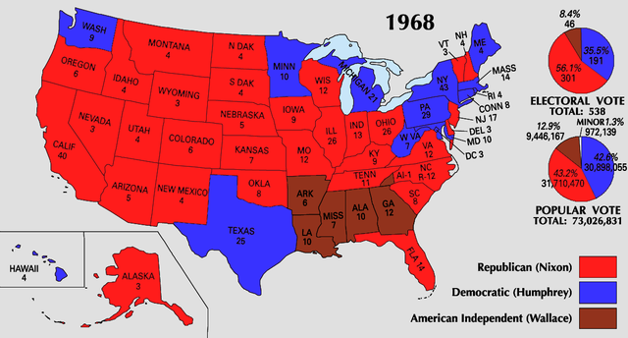

Slide 4
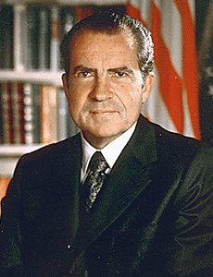
Downsizing
Nixon was backlash to liberalism
Goal was to downsize federal government
Half does this
“Law and Order”
https://www.youtube.com/watch?v=cEdtwQ8OguY
https://www.youtube.com/watch?v=S7xAuccL2Uo

Slide 5
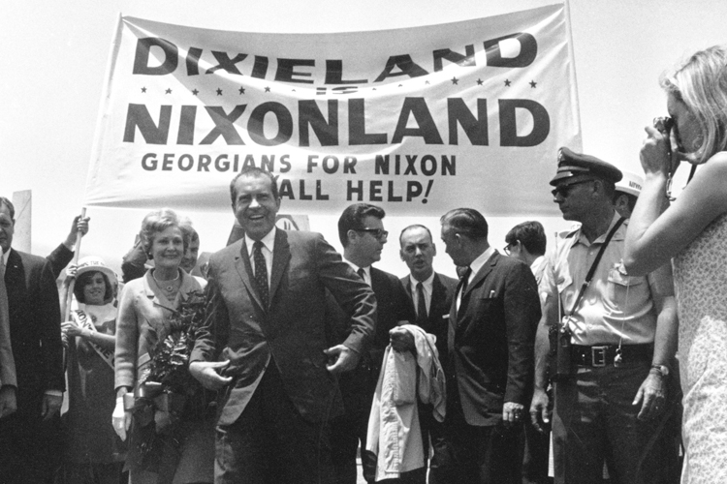
Politics
Southern Strategy
Win old southern Dem support
Slowed integration and busing

Slide 6
Economy
Stagflation
High inflation and unemployment
OPEC (Organization of Petroleum Exporting Countries)
Oil cartel of Middle Eastern countries
Controlled prices aka don’t make them mad

Slide 7
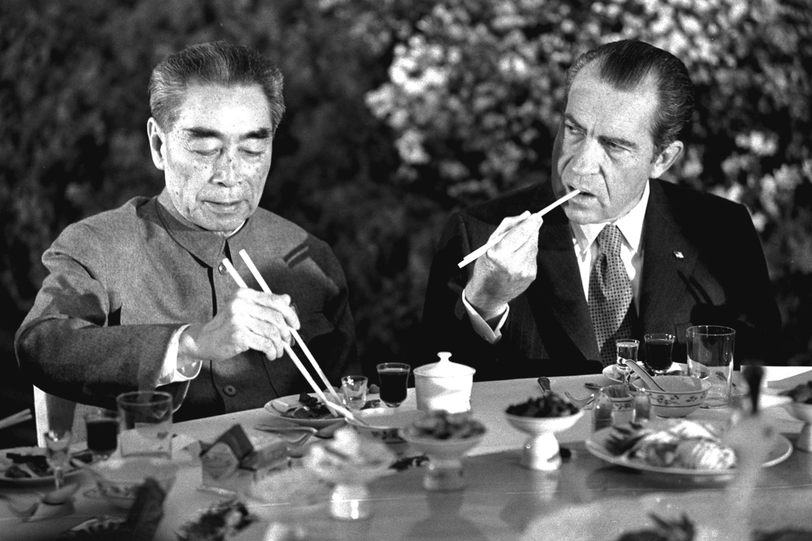
Foreign Policy
Realpolitik(Kissinger)
Think only of power not morals
Détente
Ease Cold War tensions; visit Communist country
Visits China
Moscow
SALT (Strategic arms Limitation Talks)
Limit missiles and nuclear weapons

Slide 8
