Slide 1
Age of Industry
The Guilded Age

Slide 2
Spotlight Photo

Slide 3
Brainstorm
Write anything that comes to mind when you here “Revolution”
Board
Now what might be an industrial revolution?

Slide 4
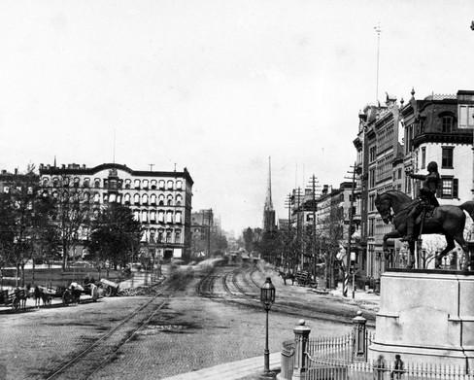

Slide 5
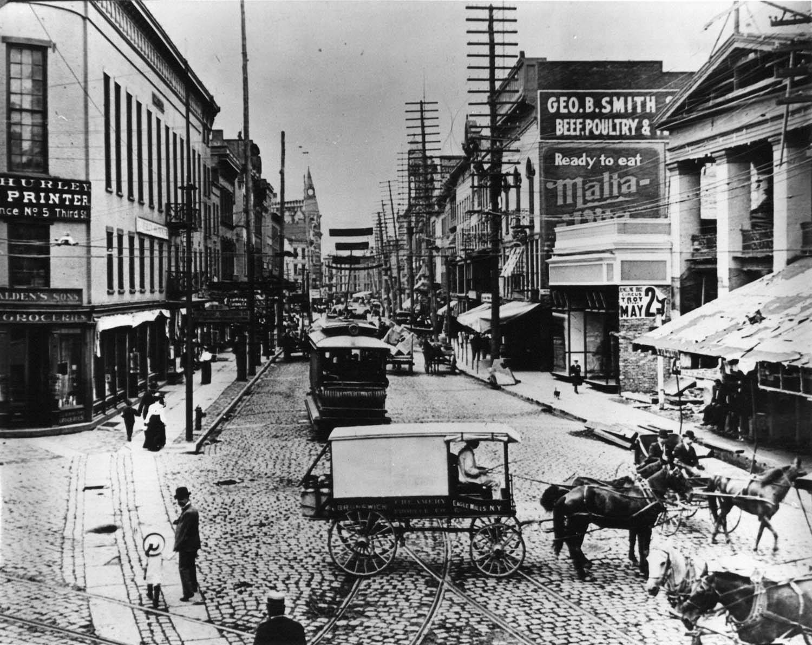

Slide 6
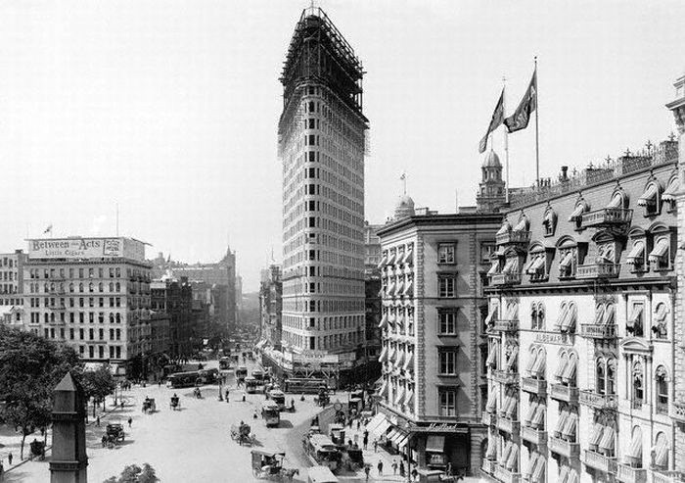

Slide 7
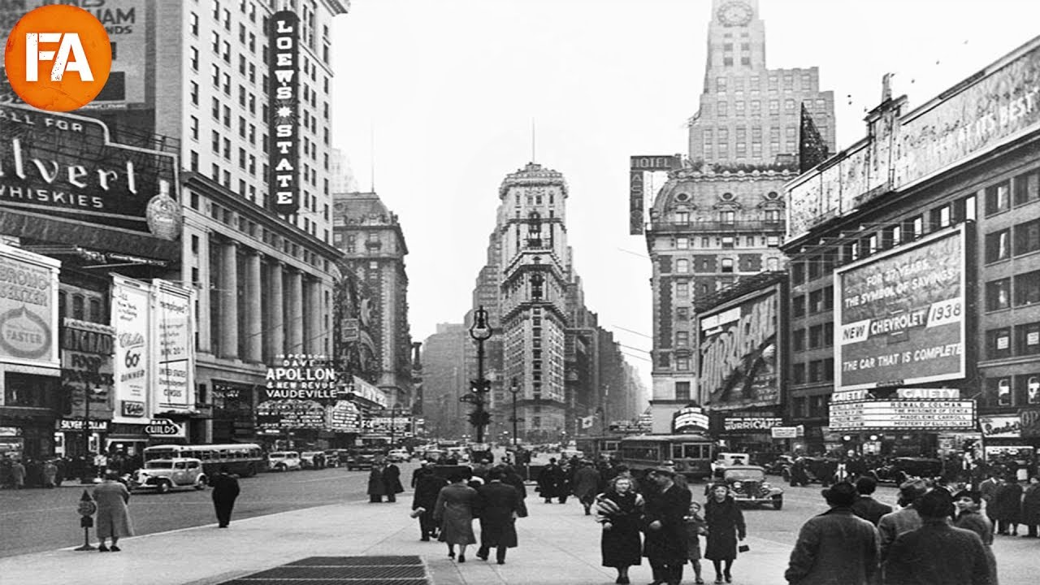

Slide 8
Brainstorm
Why would industrialization happen now?

Slide 9
Industrialization
Abundant Raw Materials
Large, able workforce
New technologies/methods
Laissez/Faire

Slide 10
Free Enterprise/Laissez-Faire
Rate how you feel on the following Topic
  Government regulation of Business (products, labor, wages, etc.)
  1-10 (1 being not involved at all and 10 being very involved)
Laissez Faire- no intervention at all
Gov. mostly honored this, but interfered for businesses often
  High Tariffs to protect domestic business
  Hands off at the expense of workers, safety, consumers, etc.

Slide 11
Technology/Methods
Electricity, Telephone, Dishwasher, Camera, typewriter
Assembly Line/Mass Production
  One person adds one part, hands to next person, and so on
Simulation
  Groups of 5
  One person for each task lined up in order
  Graham cracker on plate, frosting, unwrap 4 starburst, place starburst (windows), 4 skittles (wheels)
  Cannot pre-prepare your task; do it when it gets to you

