Slide 1
Immigration

Slide 2
“For most, the experience of steerage was a nightmare. The conditions were crowded, dark, unsanitary, and foul smelling. In spite of the miserable conditions, they had faith in the future. To pass the time they would play cards, sing, dance, and talk. Rumors about life in America, combined with stories about rejections and deportations at Ellis Island, circulated endlessly. They rehearsed answering the immigration inspectors' questions, and hours were spent learning the new language.”

Slide 3
“America…We were so near it seemed too much to believe. Everyone stood silent-like in prayer.. Then we were entering the harbor. The land came so near we could almost reach out and touch it… Everyone was holding their breath. Some boats had bands playing on their decks and all of them were tooting their horns to us and leaving white trails in the water behind them.”

Slide 4
Not like the brazen giant of Greek fame,
With conquering limbs astride from land to land;
Here at our sea-washed, sunset gates shall stand
A mighty woman with a torch, whose flame
Is the imprisoned lightning, and her name
Mother of Exiles. From her beacon-hand
Glows world-wide welcome; her mild eyes command
The air-bridged harbor that twin cities frame.
"Keep ancient lands, your storied pomp!" cries she
With silent lips. "Give me your tired, your poor,
Your huddled masses yearning to breathe free,
The wretched refuse of your teeming shore.
Send these, the homeless, tempest-tost to me,
I lift my lamp beside the golden door!

Slide 5
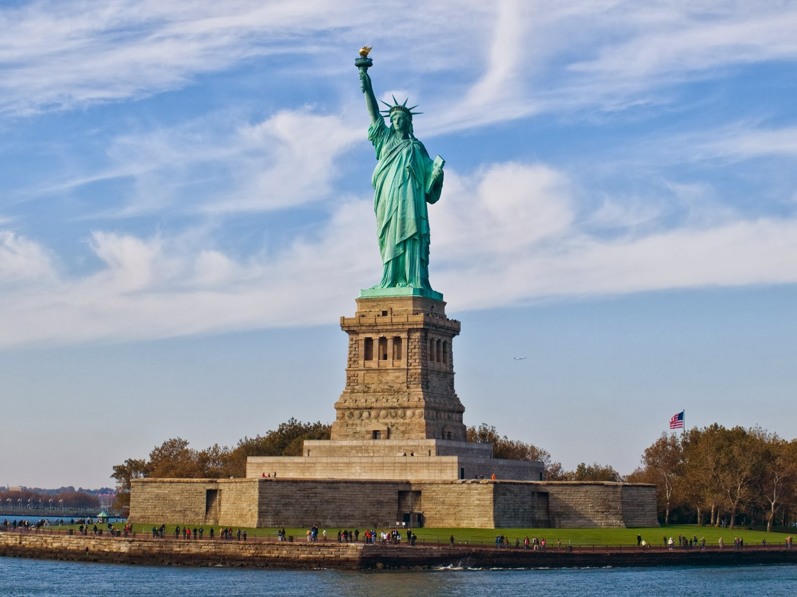
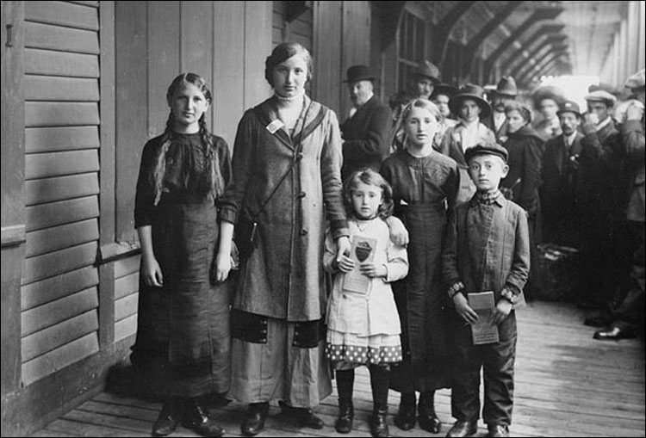
Why do people immigrate?
A better life
Escape famine, land shortage, religious/political persecution
Earn money and return home

Slide 6
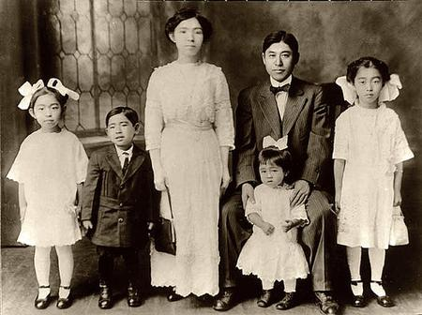
Who Immigrated? (1870-1920)
20 million Europeans
Western Europe before 1890 and Eastern after
Religious persecution
Overcrowding
300,000 Chinese
Gold
200,000 Japanese
Annexation of Hawaii
260,000 Mexican and Caribbean
Jobs
Political persecution

Slide 7
NY TimeS Map

Slide 8
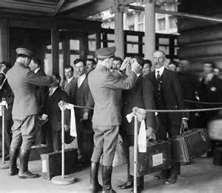
Life in the USA
Most arrived at Ellis Island (East Coast) or Angel Island (West Coast)
Physical exam
Checked documents and questioned immigrants
Could work and had money
Grouped together to survive
Combined American culture with their own

Slide 9
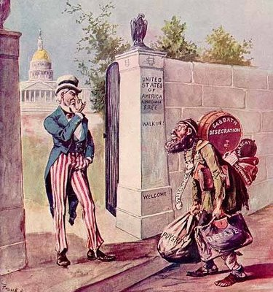
Resistance
Nativism
Anglo-Saxons were superior
Protestants who disliked Catholics, Jews, etc.
Labor unions said they took jobs
Seeing your country change can be scary/unsettling; easier to group together and oppose
Intense nationalism
Chinese Exclusion Act 1882 bans immigration for ten years
Extended another ten years in 1892
What do you think reasonable immigration restrictions are? Based on what?

Slide 10
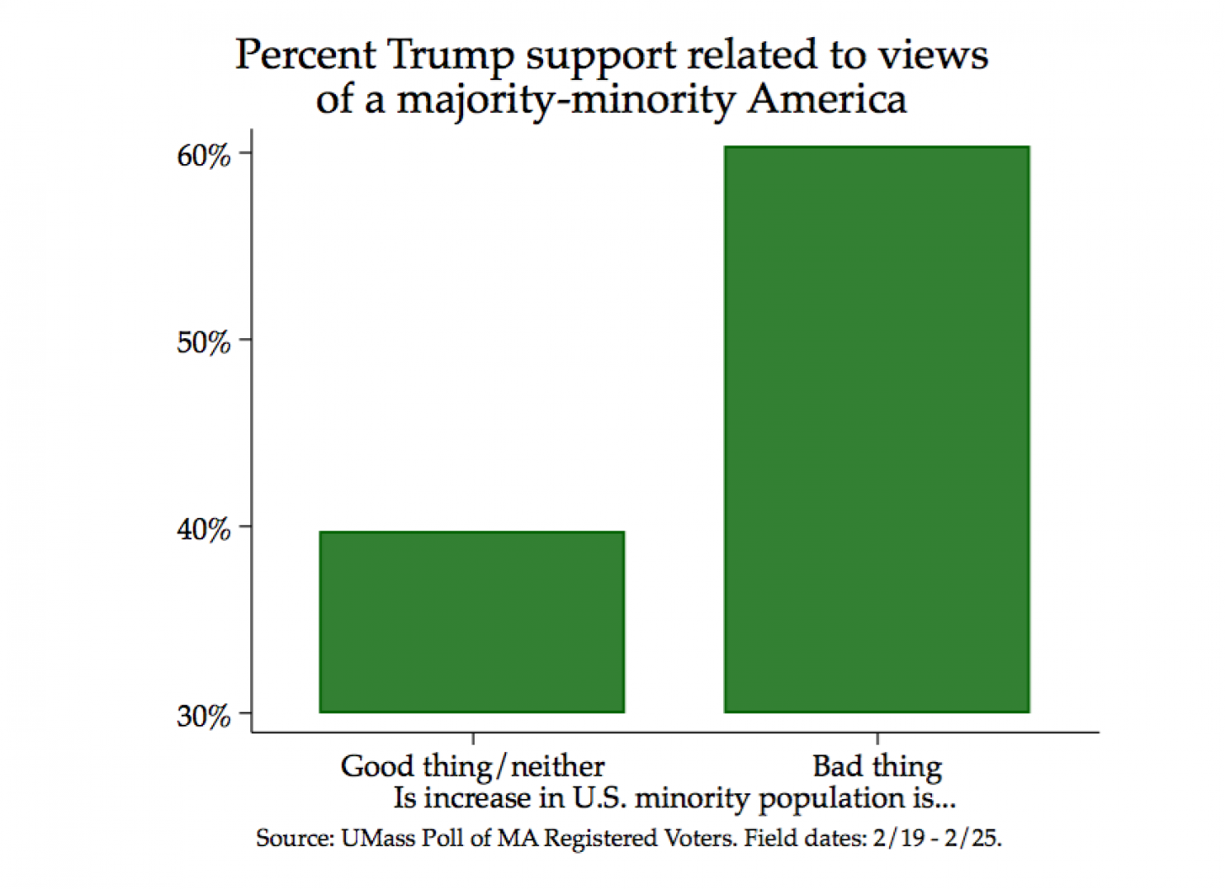

Slide 11
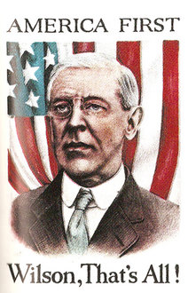
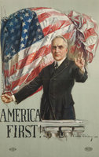
“America First”

Slide 12
Are we currently in a period of nativism?
Read and annotate the article
Racist and negative in the past; today it is more debated, not necessarily negative
Read with purpose. Question the claims presented. You don’t have to agree and shouldn’t necessarily.

