Slide 1
From Neutrality to War

Slide 2
Neutrality Act 1935
Why?
Response to growing Italian and German aggression
What?
Makes it illegal for Americans to sell arms to any country at war
Demonstrates no desire from the public to get involved

Slide 3
Neutrality Act 1936
Why?
Stop any intervention at all
What?
Extends ban on arms sales to a ban on loans to nations at war
At least if you can’t help small countries being overtaken don’t allow the big powers to borrow money etc.

Slide 4
Neutrality act 1937
Why?
Response to growing Fascist threat and desire of America to not get involved at all; Axis powers form (Japan, Italy, Germany). Try and prevent any action from drawing U.S. into war (WWI)
What?
Required any country at war to buy all nonmilitary supplies on a “cash and carry basis” i.e. no loans and no delivery (cargo ships being attacked); still can’t buy weapons

Slide 5
Neutrality Act 1939
Why?
Help Britain and France
What?
Allowed the sale of weapons on a “cash and carry” basis
FDR circumvents by giving destroyers for a naval base (technically not a purchase)

Slide 6
Lend-Lease Act
Why?
Britain running out of money to fight
What?
Allowed the U.S. to lend or lease arms to countries considered vital to the defense of the U.S.; return or pay for them after war
Developed hemispheric defense zone making all of western Atlantic “neutral”
Had to get the supplies to Britain but Germany sinking many ships; had navy patrol Atlantic to help British ships; can’t officially defend since neutral

Slide 7
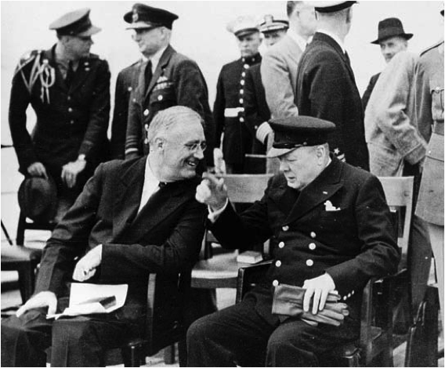
More Response (notes)
Roosevelt and Churchill meet in August 1941
Develop the Atlantic Charter
Commit to democracy, nonaggression, free trade, economic advancement, and freedom of the seas
Roosevelt trying to get more involved

Slide 8
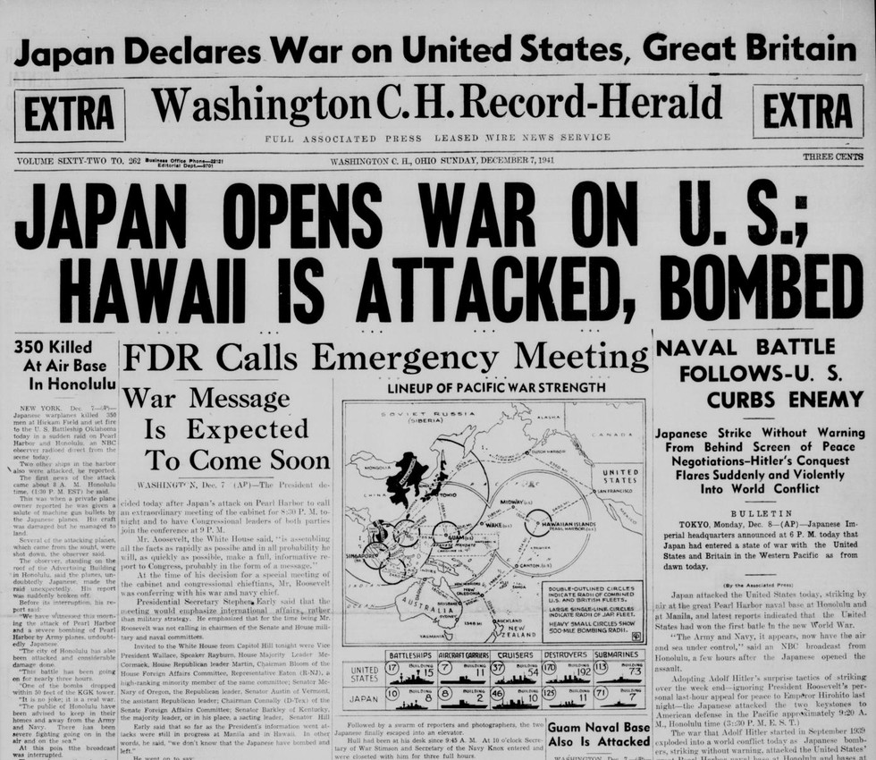
War
FDR applies economic pressure to Japan
Depend on the U.S. for oil, iron, steel etc.
FDR sends lend-lease aid to China, whom Japan was attacking
Freezes all Japanese assets in U.S.; reduces oil shipments
As U.S. and Japan negotiate Japan attacks the fleet at Pearl Harbor December 7, 1941
2,403 Americans die (largest loss of life until 9/11)
Why so shocking?
https://www.youtube.com/watch?v=YhtuMrMVJDk&t=157s

Slide 9
Four Freedoms Speech
Read and annotate the speech, answering the questions as you read
Due tomorrow beginning of class

