Slide 1
Unit 2 Vocabulary Quiz 9/20 (Thursday)

Slide 2
America The Story of Us Answers

Slide 3
Big Business and Labor
The Gilded Age

Slide 5
Corporation
Owned by many people but treated as one entity
Stockholders- hold pieces of business; company gains capital to spend
The market decides

Slide 6
Monopolies
One company controls it’s industry’s production, wages, and prices
Holding companies existed solely to buy out stock of companies (didn’t actually make anything)
J.P. Morgan
Companies would conspire to hold down prices, dump stock, etc. in pools
Corrupts idea of a free market of competing prices
Virtually unregulated

Slide 7
Credit Mobilier
Construction company set up by Union Pacific RR
Member of Congress helps
Member sells shares of company cheap to other Congressmen in exchange for votes to give UPR more land grants
Main way railroads got land

Slide 8
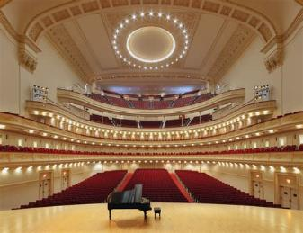
Robber Barons or Captains of Industry?
Carnegie
Steel (Bessemer Process)
Carnegie Hall
Rockefeller
Standard Oil
Vanderbilt
Railroads
Morgan
Banking
Buys out Carnegie for the first billion dollar company
Innovation and philanthropy vs. low wages and corrupt practices

Slide 11
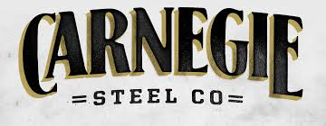
Integration
Carnegie wanted to control as much of the steel industry as possible
Vertical integration- bought out supplies needed for steel
Horizontal integration- bought out competing steel producers

Slide 12
My Business Empire
3. Treatment of Workers: Would you slash wages and crush unions to make big profits? Or would you treat workers well to create a stable but less profitable business?
4. Government Legislation: What laws would help your business grow and become more profitable?
5. Spending on Myself: Would you be frugal? Or an extravagant and conspicuous consumer?
6. Philanthropy: How would you use your wealth for the benefit of society as a whole?
Show me that you, too, could be a robber baron or captain of industry! Create your own business empire with one partner on the next page:
Start by creating “My Business” in the bottom left corner.
Business name and what it is.
Expand your business both vertically and horizontally (see the Rockefeller/Standard Oil example below for help) by filling in the small boxes extending in both directions.

Slide 13
My Business Empire
Treatment of Employees
Government Legislation
Vertical Integration
Spending on Myself
Philanthropy
My Business:
Horizontal Integration

Slide 15
Advertisement
Department stores brought together these wide array of products to sell
Sears
You are responsible for creating an advertisement for your company/product on a sheet of printer paper
You will present your Business Empire and Advertisement at the end of class tomorrow

Slide 16
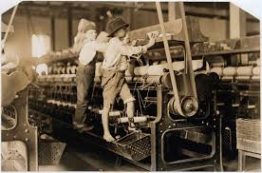
Labor Unions
Laborers were exploited
Seven day workweek
12 or more hours per day
No benefits or time off
Injuries
Dirty factories with no safety regulations
Low wages
Often every family member had to work (even children)
Example: Men made $498 per year, women made $267 per year, Andrew Carnegie made $23 million with no income tax

Slide 17
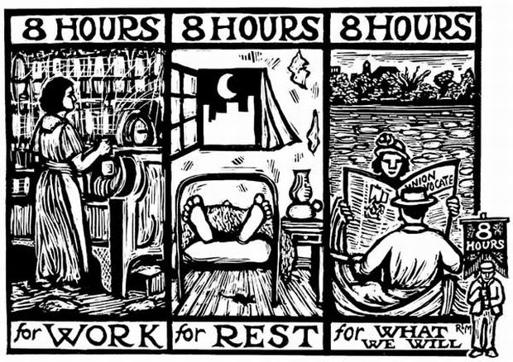
Labor Unions
First was the National Labor Union
Link local unions
Knights of Labor
Focused on individuals
Used bargaining
American Federation of Labor
Craft Union (skilled workers)
Closed shop (hire Union only)
Samuel Gompers Used strikes
Blacklisted

Slide 18
Socialism
Huge inequalities between workers and owners turn many to Socialism led by Eugene Debs
Government control of business and property with equal wealth distribution
Karl Marx advocates overthrow of capitalism
Industrial Workers of the World
Unskilled workers
“Wobblies”

Slide 19
Strikes Map

Slide 20
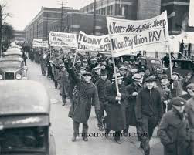
Strikes
1877 Strike
Railroads for low wages
50,000 miles of track comes to a stop
Hayes ends it with federal troops
Haymarket Square
Protest police brutality
Bomb thrown at police who fire
Homestead Strike
Wage cuts
Pullman Strike
Wage cuts and layoffs
Grover Cleveland sends in federal troops

Slide 21
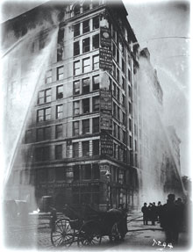
Women Organize
Mary Harris Jones
Led 80 mill children with horrific injuries to protest outside Theodore Roosevelt’s home
Triangle Shirtwaist Factory Fire
Fire starts and only one door was
unlocked
No sprinkler system
Fire escape collapsed
146 women die

