Slide 1
“Rouge means that women want to choose their man-not take what lives in the next house…Look back over the pages of history and see how the loveliness of women has always stirred men-and nations-on to great achievement! There have been women who were not pretty, who have swayed hearts and empires, but these women…did not disdain that thing for which paint and powder stands. They wanted to choose their destinies-to be successful competitors in the great game of life.”

Slide 2
20’s Culture

Slide 3
Brainstorm
What is culture? How does it develop?
Creativity, safety, free time
The newfound productivity of machines and inventions made tasks that normally took hours take minutes
More free time now to explore hobbies, interest, be creative, and invent

Slide 4
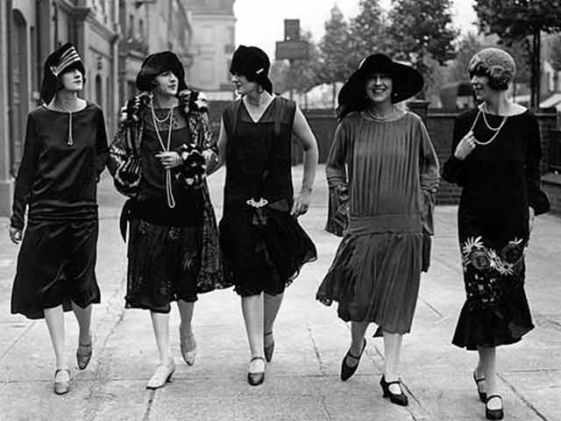
Women
Flappers
Emancipated women who embraced new urban fashions
Shedding old images
The Double Standard
Stricter standards for women
Changing Family
Declining birthrate
Margaret Sanger birth control

Slide 5
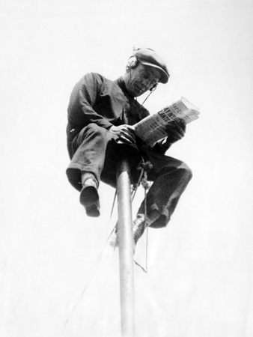
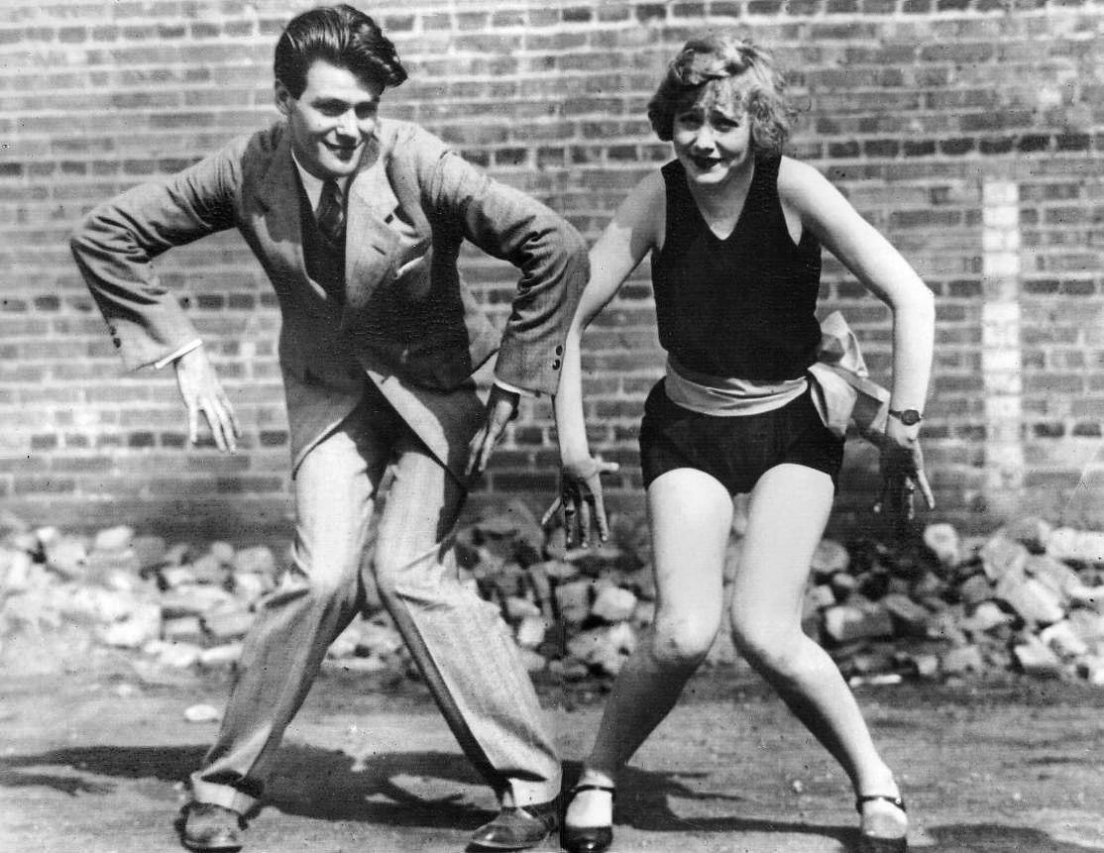
Youth Culture
https://www.youtube.com/watch?v=05kzS9nFv_w
https://www.youtube.com/watch?v=9AXA2bwL6eY

Slide 6
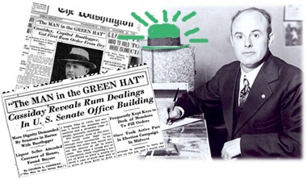
Prohibition
The 1920’s is the apex of prohibition…for some
Many found ways around it and an entire crime industry is created because of it (bootleggers)
https://www.youtube.com/watch?v=ynnftRDaEcc

Slide 7
Literature
Mass Media- new access to information (Podcasts today)
Newspaper circulation increases
Radio
Lost Generation
Disilliusioned with the new consumerism and material goods
Ernest Hemingway, F. Scott Fitzgerald
The Great Gatsby
“They were careless people, Tom and Daisy- they smashed up things and creatures and then retreated back into their money or their vast carelessness, or whatever it was that kept them together, and let other people clean up the mess they had made.”

Slide 8
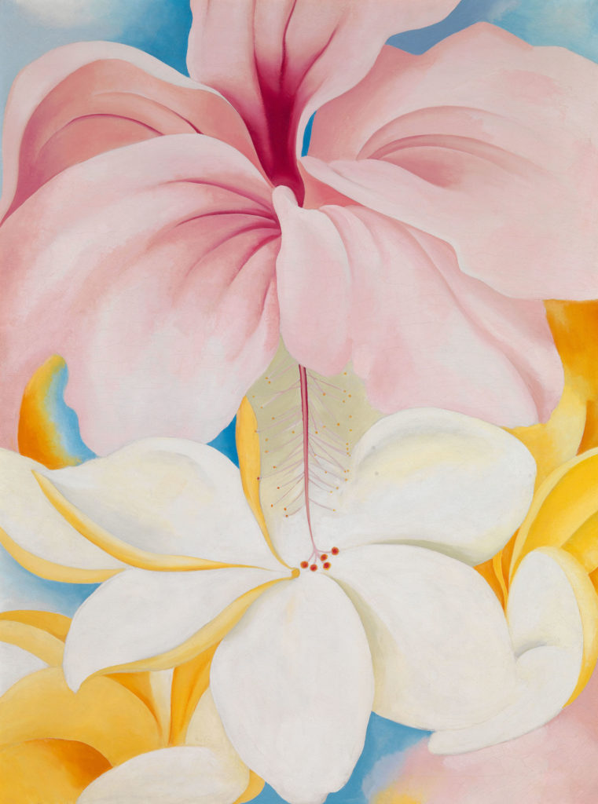
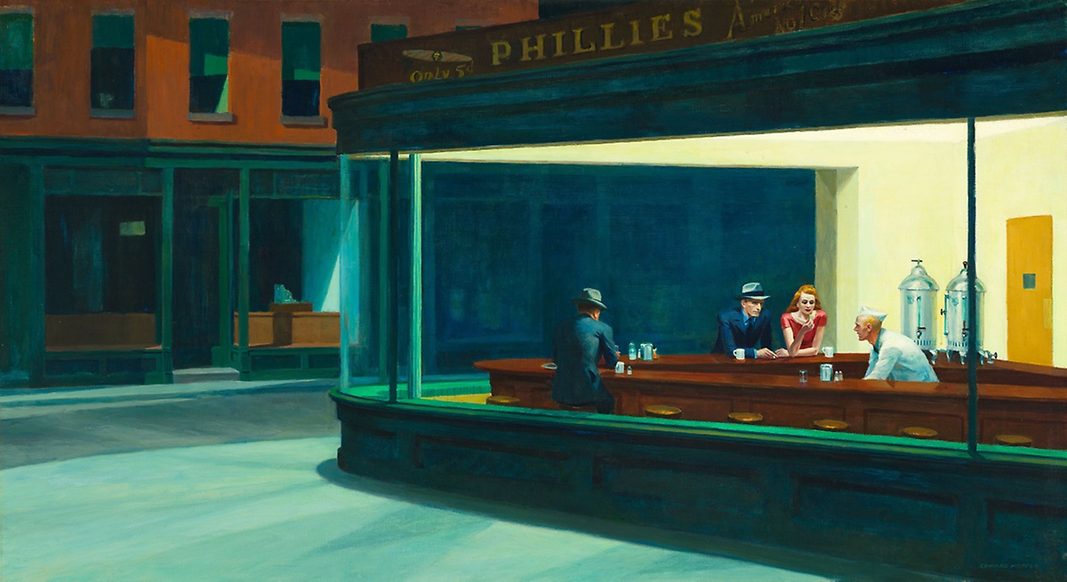
Art
Reflected disenchantment and isolation as well as realism
Edward Hopper and Georgia O’Keeffe

Slide 9
Movies
First “talking” picture was The Jazz Singer
https://www.youtube.com/watch?v=j48T9BoKxlI
Stories of WW1, new dynamics of gender and race
Helped unify the nation through shared experience

Slide 10
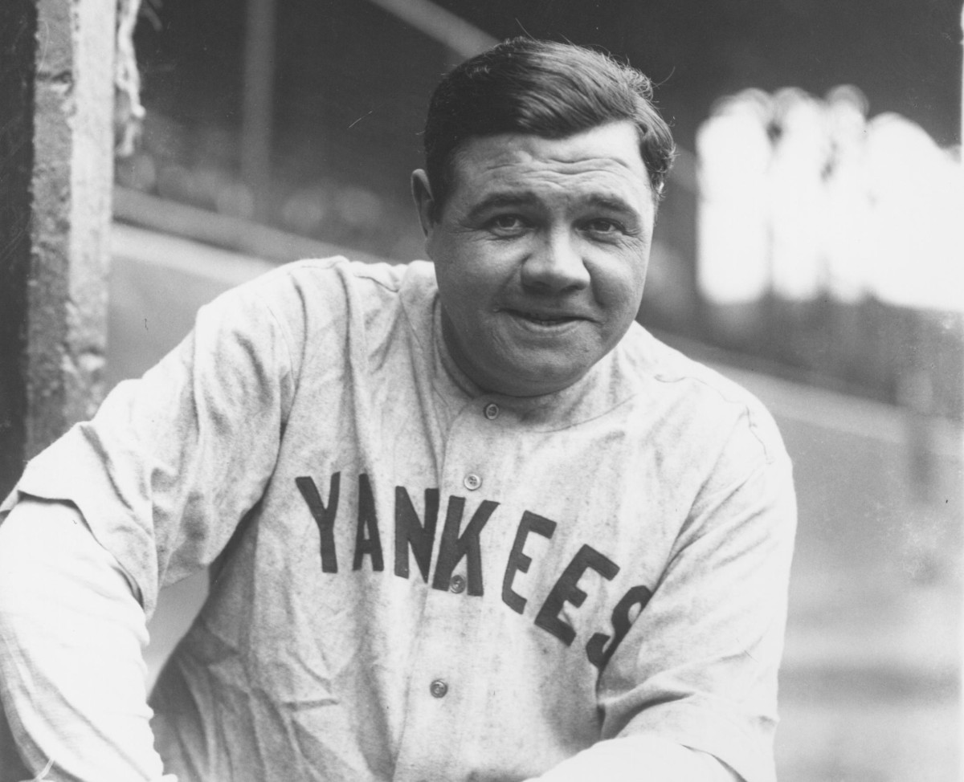
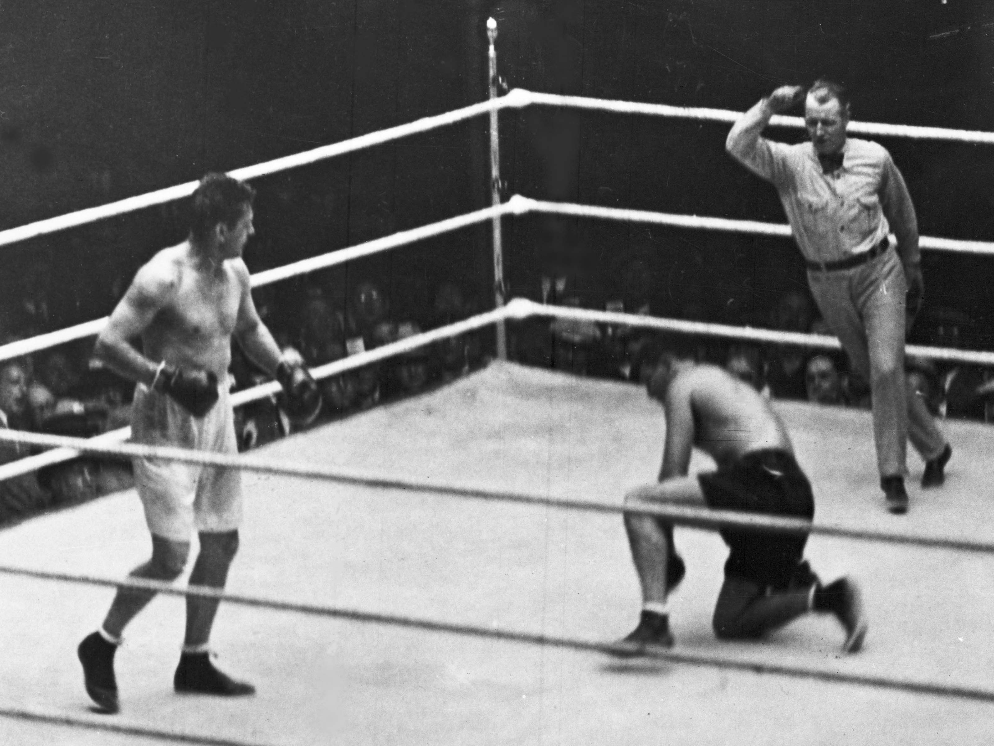
Sports
Basketball, baseball, boxing becoming mainstream
https://www.youtube.com/watch?v=-OeeCfbahwQ

Slide 11
Assignment
Write 5 Tweets from the perspective of a youth living in the 1920’s
Each tweet should have at least one hashtag and one slang term from the list given.
These should be creative and can be about anything from 1920’s popular culture
Dancing
Sports
Movies
New roles for women
Art
Literature
When finished, hang on to it and we will share before turning in at the end of class

